Slide 1
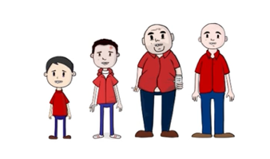


Adverse Childhood Experiences &
The Importance of Building Resilience
Professor Mark A. Bellis
Director of Policy and International Health
World Health Organization Collaborating Centre on Investment for Health and Well-being
Public Health Wales
Email: m.a.bellis@bangor.ac.uk; Twitter @markabellis
World Health Organization Collaborating Centre on Investment for Health and Well-being

Slide 2
Adverse Childhood Experiences ACEs - The Life Course
Death
Early Death
Non Communicable Disease, Disability, Social Problems, Low Productivity
Life Course
Adopt Health Harming Behaviours and Crime
Social, Emotional and Learning Problems
Disrupted Nervous, Hormonal
and Immune Development
Increase the risk of ↑
ACEs Adverse
Childhood Experiences
Birth
Probabilistic relationships and not Deterministic one
Other factors can change the strength of the relationship
Bellis 2016
Developed from Felitti et al. 1998

Slide 3
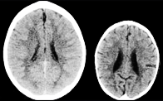


Bio-molecular Developments
Brain Development and Neglect
Physical and Sexual Abuse
  C-reactive protein (Liver) - Deals with pathogens and damaged cells
  Interleukin 6 - Immune system linked to tissue damage
  Linked Diabetes II, Cardiovascular disease
Telomere length
  Length is a marker of cell ageing
  Physical Abuse, Parental alcohol and drug use
Baumeister et al., Mol Psychiatry. 2016 May; 21(5): 642–649.; Perry, Society For Neuroscience: Proceedings from Annual Meeting, New Orleans, 1997, Puteman et al., vol. 113 no. 42, E6335–E6342, doi: 10.1073/pnas.1525602113

Slide 4



Physical abuse 16%
Adverse Childhood
Experience
Sexual abuse 7%
Domestic violence 17%
Parental separation 25%
Parental death
Emotional neglect 5%
Homelessness
Physical neglect 4%
Bullied
Displacement
Mental ill health 18%
Household Anxiety ↑
Domestic Violence?
Poverty ↑
Alcohol problem 13%
Street drug user 6%
Incarcerated 4%
Poverty
Discrimination
Poor housing
Local Violence
Lack of Opportunity
Adverse Community Environments

Slide 5
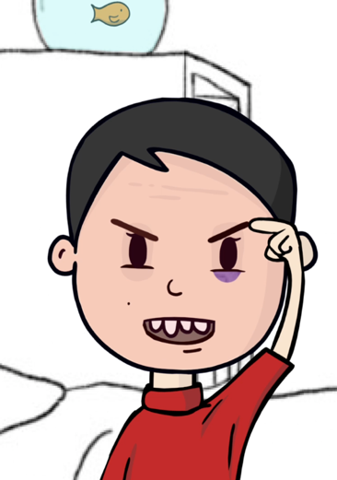

Child Health and Concurrent ACEs
(Age under 18 years)
Somatic complaints
  Include - Headaches, Digestive problems, Skin disorders
Child victims of abuse
  Age 6-7 years 58%↑ risk of not achieving basic language & maths
  Independent of deprivation
Reference = 0 ACEs
Egger et al 1999, Flaherty et al, 2013, Bellis et al, BMC Public Health, 2018 n=2452; Evans et al, in 2020
.

Slide 6

Wales: Length of Healthy Life
Individuals Diagnosed with a Major Disease by Age (%)
0 ACEs
4+ ACEs
Differences remain after adjusting for Deprivation
Major Diseases
Cancer
Stroke
Type 2 Diabetes
Cardio Vascular Disease
Digestive/Liver Disease
Respiratory Disease
41%
10-15 years
21%
10-15 years
Adverse Childhood Experiences and their association with chronic disease and health service use in the Welsh adult population; 2016

Slide 7
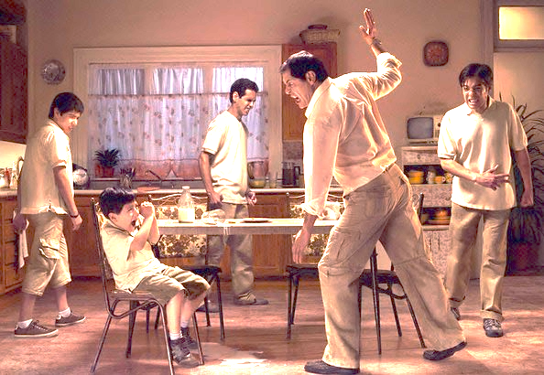

Hit Someone in Last 12 months
Ever Adult Victim of
Intimate Partner Violence
(England and Wales Crime Survey)
Males
40%
0 ACEs
1 ACE
Victim of childhood:
Psychological abuse
Physical abuse
Sexual abuse
Witness to domestic violence
2-3 ACEs
4+ ACEs
6%
Odds of being adult victim One ACE ↑x3.3
Multiple ACEs ↑x6.4
Age Group
(n= 19,471; Butler, Quigg, Bellis 2020)
(England and Wales; n>15000)

Slide 8

Collaborative Global ACE Analysis with WHO
PHYSICAL HEALTH
WEIGHT & EXERCISE
SEXUAL HEALTH
2.1
1.5
1.2
1.4
Physical
inactivity
2.2
2.2
Heart disease
Diabetes
Obesity
2.8
Smoking
2.3
Poor self-rated health
Heavy alcohol use
3.6
Cancer
Multiple
sexual partners
2.8
Liver/digestive disease
3.7
4+ACEs
Vs
No ACEs
Early sexual initiation
3.0
Respiratory disease
4.2
Teenage pregnancy
3.7
Anxiety
Illicit drug use
5.6
4.4
Low life satisfaction
Problem alcohol use
Depression
Victimisation
Suicide attempt
Problem drug use
5.8
4.4
Violence
perpetration
STIs
7.5
30.1
10.2
5.9
8.1
Hughes, Bellis, Hardcastle et al, 2017 Lancet Public Health
MENTAL HEALTH
VIOLENCE
SUBSTANCE USE

Slide 9
The Costs of ACEs in England
HUMAN CAPITAL MODEL- assign a monetary value to loss of health calculated as reduced or lost economic productivity.
£ 7.4
£
7.5
£Billions
Per year
£
6.6
£
4.9
£
4.1
£
5.1
£
2.2
£
2.5
£
3.1
£
0.7
£
1.7
£
0.4
£
1.2
Fraction attributable to ACEs
ACEs explain only a proportion of these conditions
But that equates to ACE Attributable £40.6 Billion/Year
BMJ Open, Hughes, Ford, Kadel, Sharp and Bellis, 2020

Slide 10
Tackling Adverse Childhood Experiences
Socio-economic and other Marco drivers
Tackling Violence & ACEs
Prevention
Resilience
Trauma informed
Services
ACEs
Can be prevented
Consequences↓
  Resilience↑
  Trauma informed approaches

Slide 11
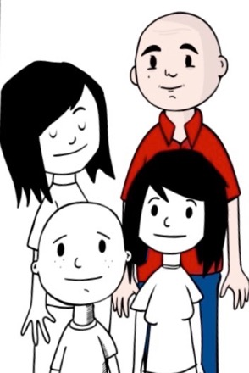
Supporting Parents – Preventing ACEs
Nurse Home
Visiting
Child maltreatment
⬇ Child injury
Parenting
Programmes
⬆ High School completion
  Preschool
  Enrichment
⬇ Violent offences
⬆ Employment in mid 20s
Sethi et al, 2013
Not just new programmes but ensuring existing services are informed and integrated

Slide 12

Resilience
transforming potentially toxic stress into tolerable stress
A safe space in which physiological and psychological systems can reset to a tolerable level
Always
Available Adult
that you trust
Based on Strengthening the Foundations of Resilience, Harvard, 2015; Wales ACE Survey, 2015, n=2028, unpublished data

Slide 13

Resilience
Culturally Connected
Always Available Adult
Always Available Adult
I had people I looked up to
Getting an education was important to me
I enjoyed my community’s cultures and traditions
My parents, caregivers knew a lot about me
I had opportunities to develop skills to help me succeed in life
I tried to finish activities that I started
I was treated fairly in my community
I was able to solve problems without harming myself or others
My family would stand by me during difficult times
I knew where to go in my community to get help
Guide your destiny and overcome Hardship
Manage your behaviour and emotions
I felt I belonged in my school
The Resilience Research Centre Adult Resilience Measure (RRC-ARM), Wales, 2017The Resilience Research Centre Adult Resilience Measure (RRC-ARM), Wales, 2017

Slide 14
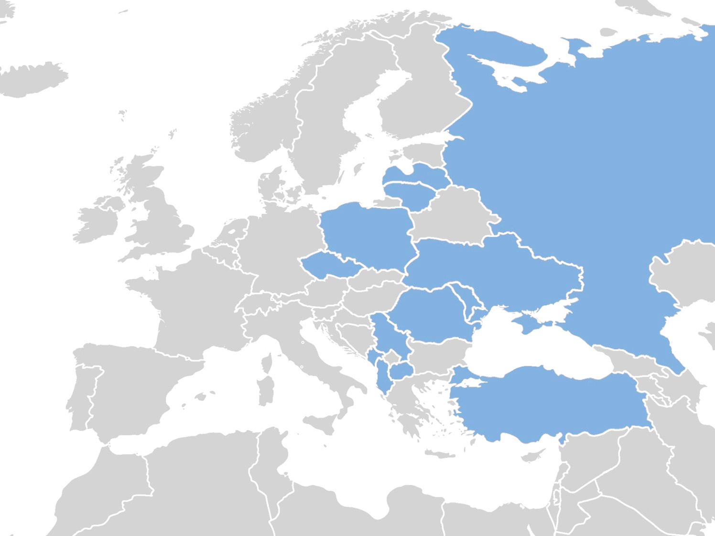
Low Childhood Resilience = Most missing from
Felt important or special; Felt loved; Someone to take care of and protect them.
In Family, looked out for each other, felt close, source of strength and support
ACEs & Resilience Assets in Eastern Europe
Suicide Attempt
School Absenteeism (>20 days/year)
ACEs and Resilience
Resilience
Low
High
Bellis et al, BMC Public Health, 2018

Slide 15







ACEs in Challenging High Schools
Example from Washington State Family Policy Council
ACEs
  1/3 of class 4+ ACEs
  Best predictor of attendance & behaviour
  Educational success related more to ACEs than poverty
Change
  Public Health & others inform staff about impacts of ACEs
Wales
2/3 all schools in Wales CE/Trauma trained
Head teachers describe as transformational
Reducing exclusions
Enquiry
Why
Competency
Resiliency and developmental skills
Attachment
Care-giver relationships
Self-Regulation Control/Share emotional experience
75%⬇
Fights
83%⬇
Suspensions
798 ➔ 135
⬆ Graduation rates
/www.resiliencetrumpsaces.org; communityresiliencecookbook.org/tastes-of-success/

Slide 16











  Trauma Informed Approaches
Waiting for issues to reach a certain specialist threshold?
!
Sexual abuse
Non-specialist health, education and criminal justice agencies training on dealing with trauma
Domestic Violence
Physical Abuse
Mental Health
Drug Use
Separation
Alcohol Abuse
Incarceration
Verbal Abuse
Early Action Together Programme, Wales
Notes:
Schools Icon and Police Icon and Public

Slide 17
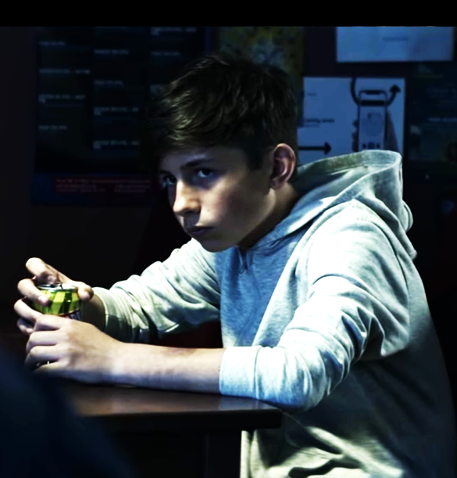
Mobilising the Public Sector & Public
Survey - around 3000 public sector employees in Wales (May -June 2019)
  67% seen information on ACEs
  47% offered training in the last 18 months with ACE information
National ACE Campaign
Time to be kind
www.youtube.com/watch?v=fgFU29OF0ow
Riley GS, Bailey JW, Bright, D, Davies AR. (2019)

Slide 18
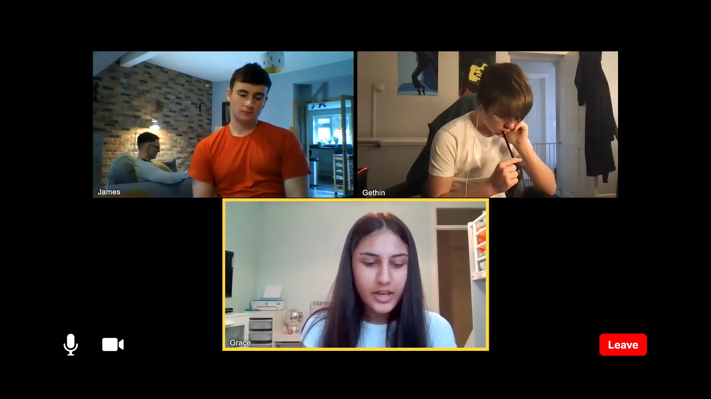
Supporting those suffering during a Pandemic
https://youtu.be/x3LyFDDopm8

Slide 19
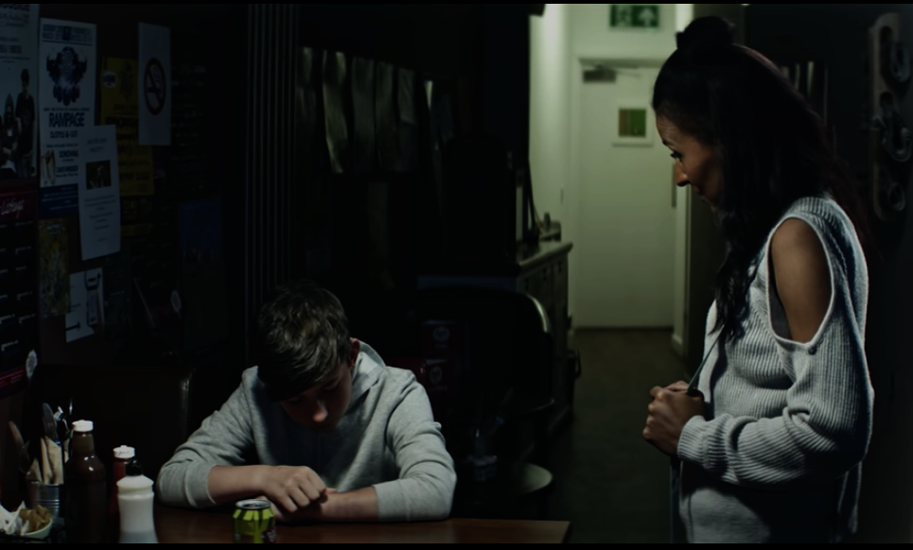
Poor Mental Well-being
Deprivation, ACES and Resilience
4 ACEs, Always Trusted Adult in Childhood = No
4 ACEs, Always Trusted Adult in Childhood = Yes
0 ACEs, Always Trusted Adult in Childhood = No
0 ACEs, Always Trusted Adult in Childhood = Yes
Mental Well-being measured using the short Warwick Mental Well-being Scale (Low MWB >1 standard deviation below the mean)

Slide 20
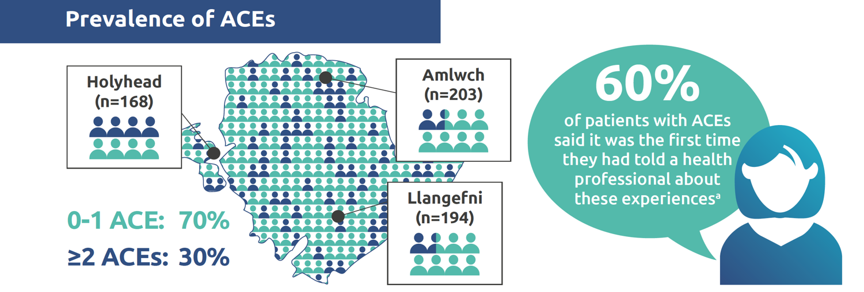
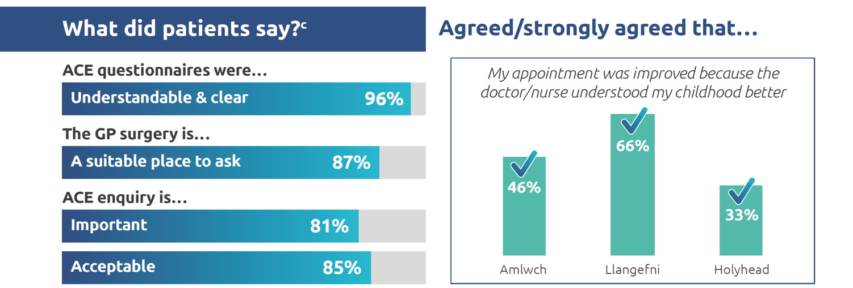
Asking about Adverse Childhood Experiences in General Practice

Slide 21
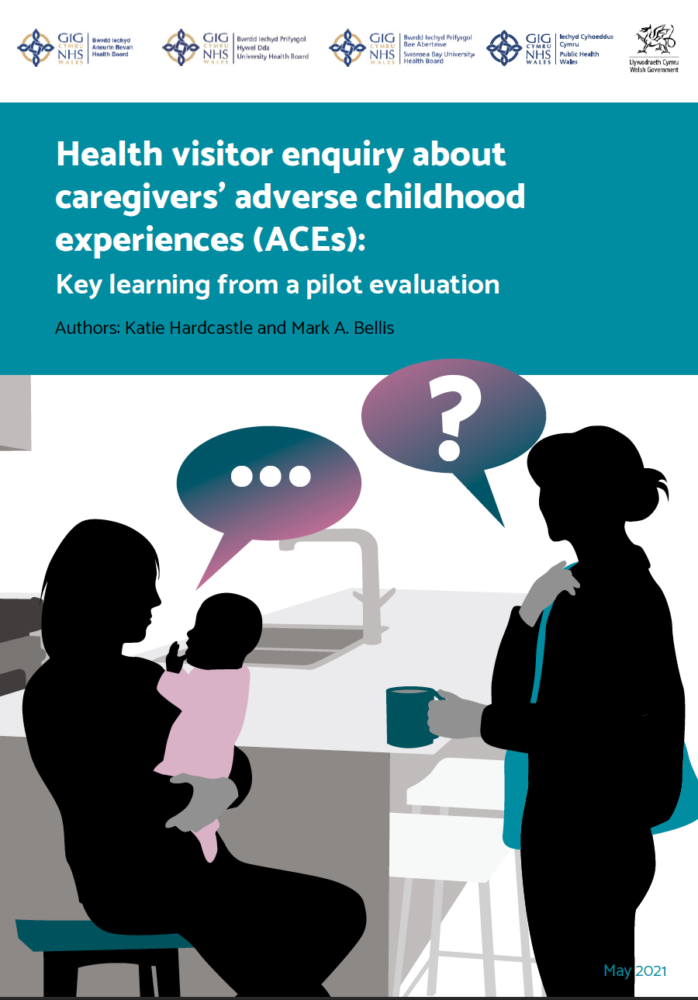
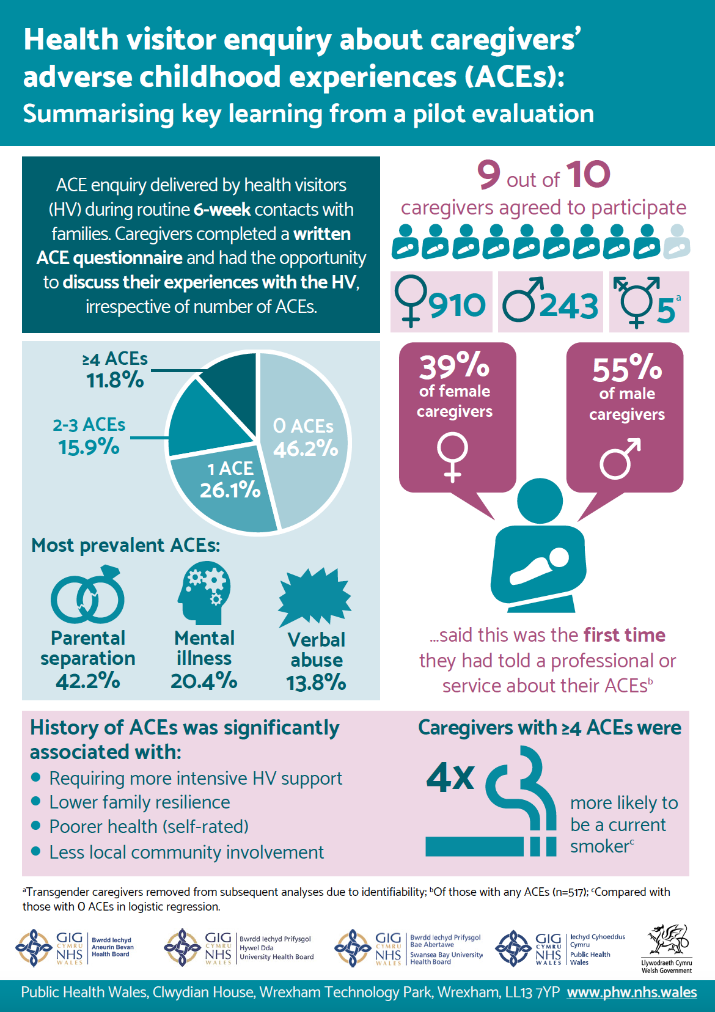
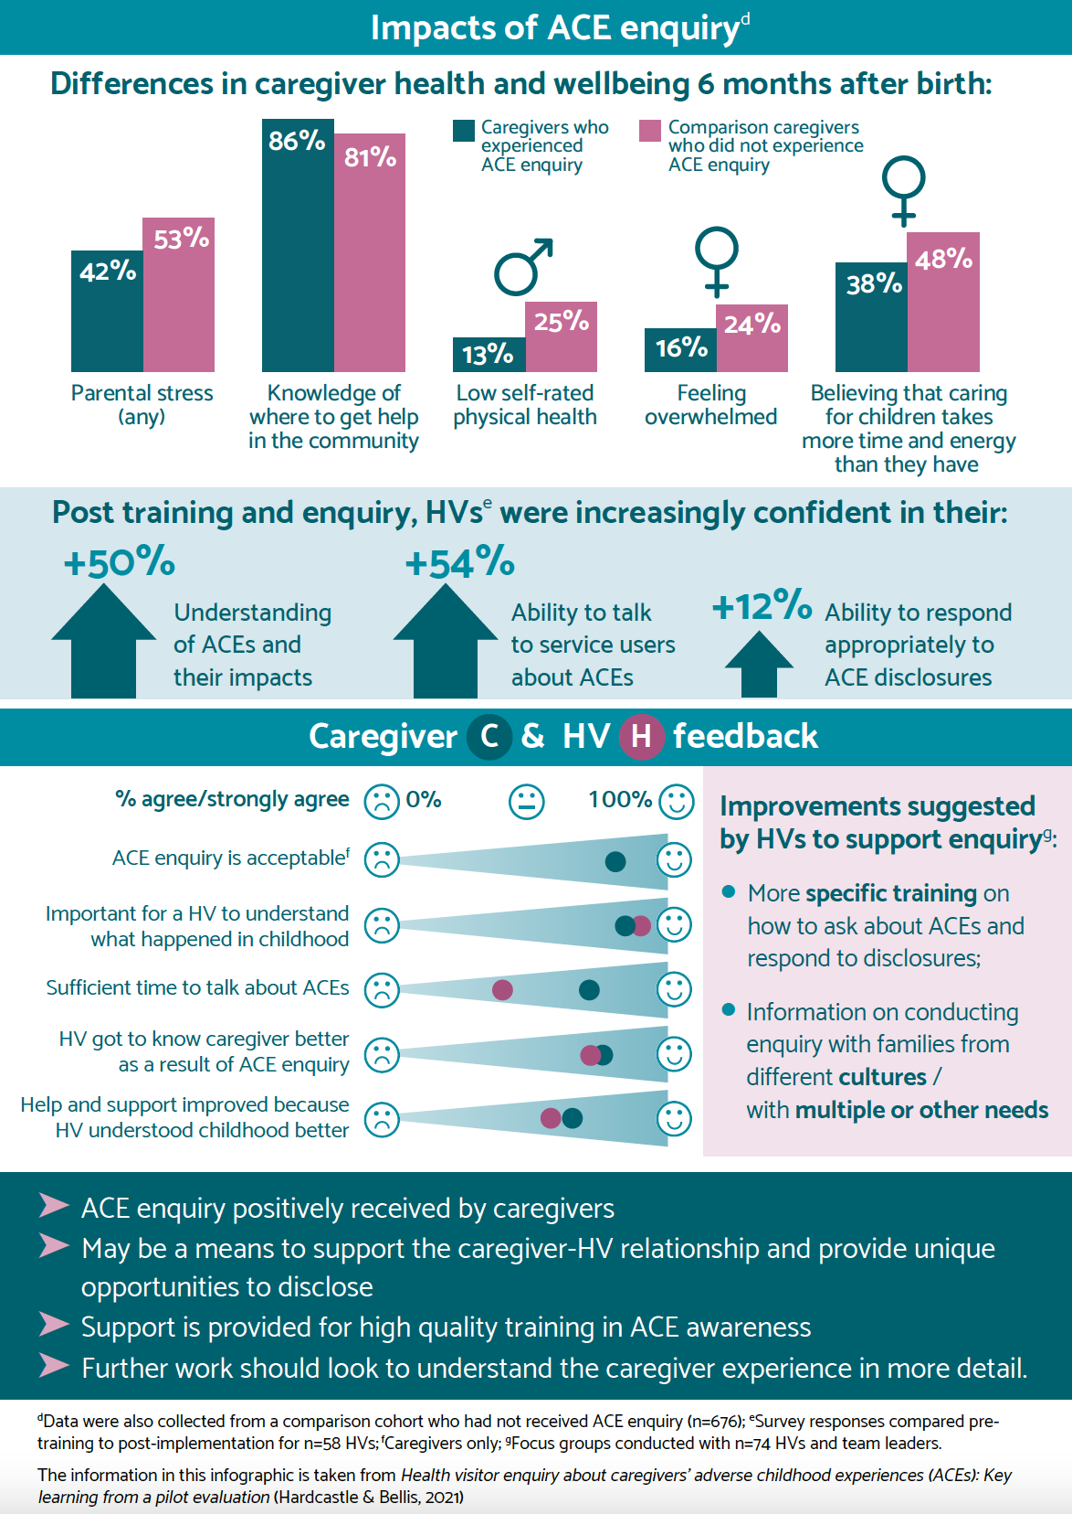
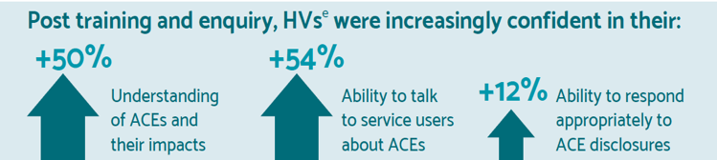
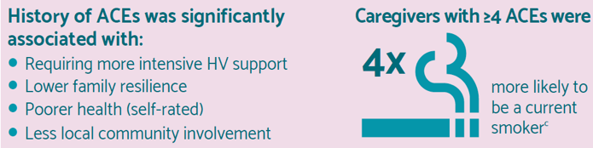

Slide 22


Perceptions of service supportiveness as not supportive at all
Low Trust in NHS COVID Information
4+ACEs
0 ACEs
1 in 25
Affluent
no ACEs
% not supportive at all
1 in 5
Deprived 4+ACEs
Vaccine Hesitancy

Slide 23





PRINCIPLES OF TRAUMA INFORMED CARE
Trust
Safety Ensuring physical and emotional safety
Empowerment, Choice and Control For people who have had control taken away, having small choices makes a big difference)
Collaboration Maximising collaboration

Slide 24


Childhood Adversity as Motivator?
Creativity in Performing Arts
Excellence in Sports Performance
Preference for Caring Careers

Slide 25


Trauma Informed Prevention of
Adverse Childhood Experiences
A Taskforce of the European Healthy Cities Network
.

Slide 26
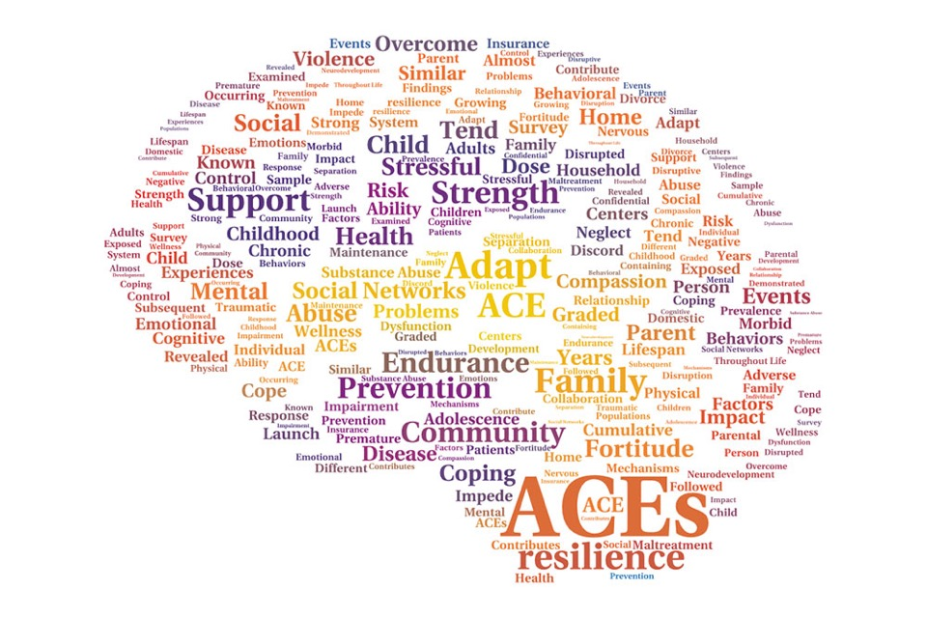
ACEs and Trauma Informed Responses
Prevention is possible
But COVID-19 likely to increase risk of ACEs
Major cause of Non-Communicable Disease
Exposes Health and Economic value of good parenting
Need consideration across the life course
Develop individual and community resilience
Services that understand ACEs
  appear to offer a more holistic, life course response
  More easily see a joint agenda for Health, Social, Education and Crime
Inter-generational benefits from breaking the cycle
Better informed parents make better life-course choices
A trusted adult can make a remarkable difference

Slide 27

Watch the ACEs Animation on YouTube
youtu.be/YiMjTzCnbNQ
Professor Mark A. Bellis
Director of Policy and International Health
World Health Organization Collaborating Centre on Investment for Health and Well-being
Public Health Wales
Email - m.a.bellis@bangor.ac.uk
Twitter - @markabellis
World Health Organization Collaborating Centre on Investment for Health and Well-being

