Slide 1
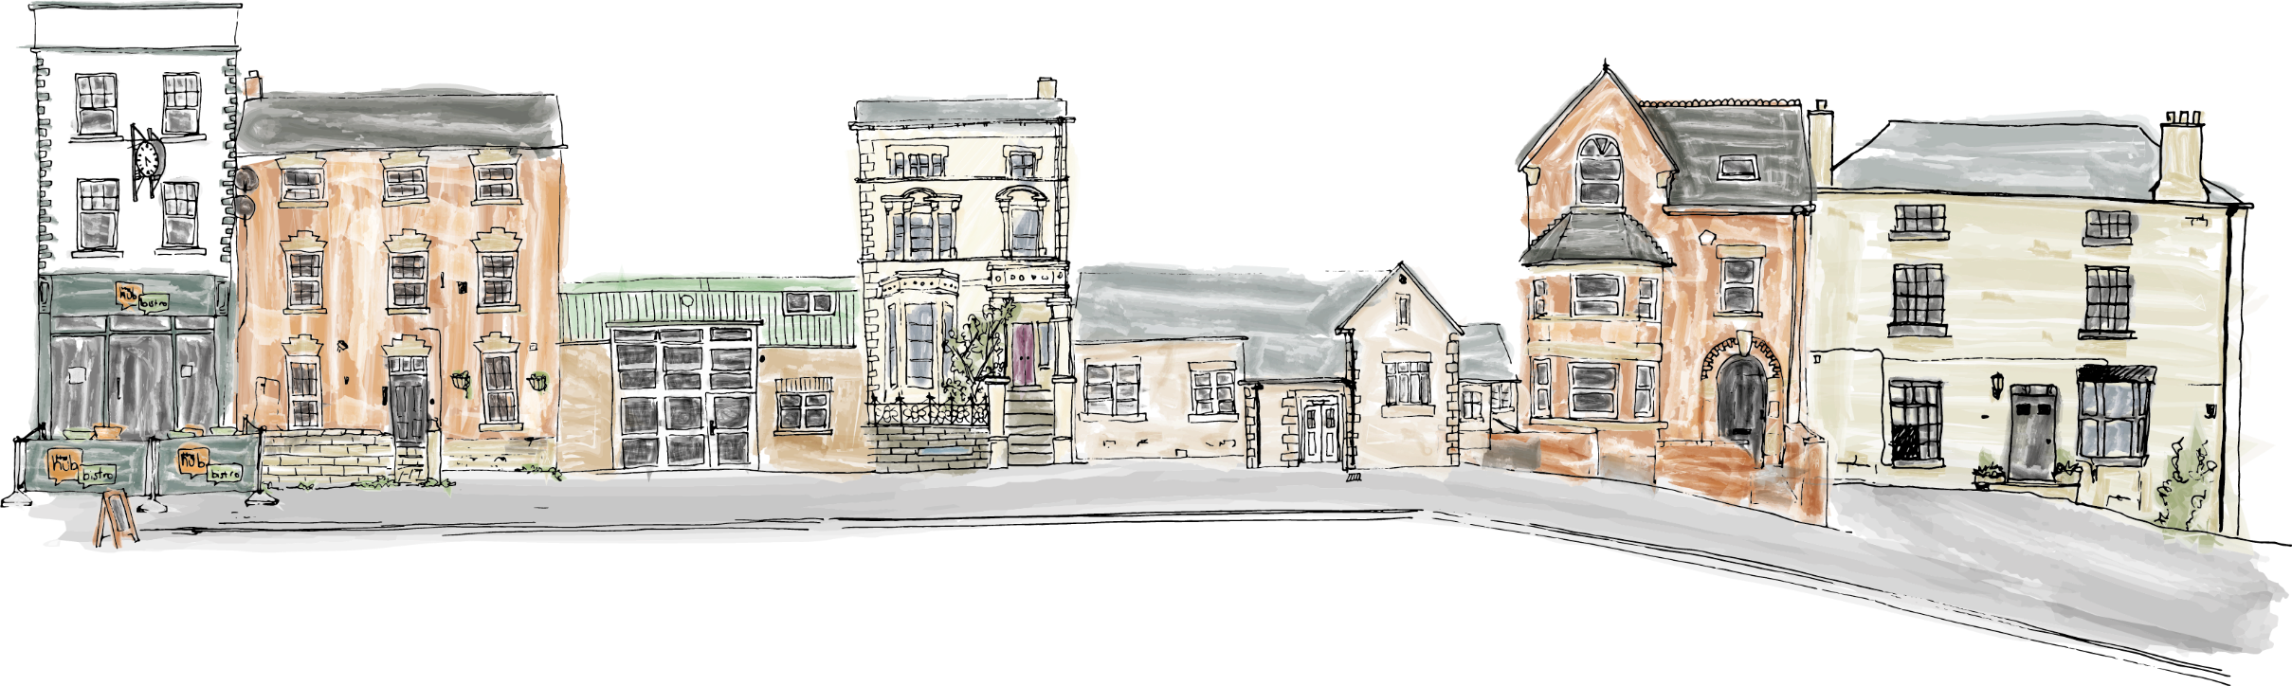

Wellbeing, Resilience and practitioner self-care
Notes:
Change masks – only do in small groups
Fluctuating resilience and ACES

Slide 2
The Nelson Trust – Who are we and what do we offer?
Residential Addiction Treatment Services:
Mixed Gender
Women Only
Resettlement Service
Recovery Focused Social Enterprises:
The Hubs – Hub Eats, Learning Academy, Maintenance team
Women’s Community Services:
Women’s Centres in Gloucester, Swindon and Bridgewater, Bristol
Women involved in the Criminal Justice System
Prison In-reach
Sex Worker Outreach Projects
Women experiencing multiple disadvantage

Slide 3
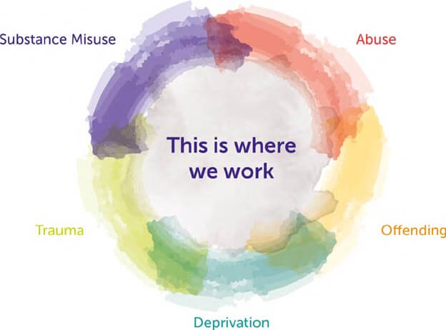

Slide 4
Needs of the population we serve
High levels of self neglect
Disrupted ability to self regulate
Impulsivity
Self injury/Suicidality
Trauma responses
High problem severity (dependence)
Multiple push & pull factors

Slide 5
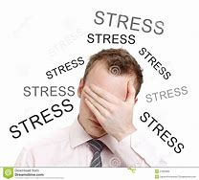
What is a definition of stress?
Stress is defined as a person's response to his environment. Stress is measured in terms of arousal or stimulation. As such, stress must be present for a person to function.
Each person has his own normal (homeostatic) level of arousal at which he functions best. If something unusual in the environment occurs, this level of arousal is affected.
Notes:
Read slide

Slide 6
The stress response
The stress response was only ever meant to happen for brief periods of time.
In the right doses, cortisol (the stress hormone) which surges through the body in times of stress will help us to perform at our peak.
When the cortisol is turned on and off quickly, it energises, enhances certain types of memory, and sets the immune system to go
So sometimes….stress is good
Notes:
Read slide and emphasise that often, stress gets a “bad press” however short bursts of tolerable stress can actually increase our focus and performance, and that we’ll look into how to identify the different categories of stress and how we manage them over the coming slides

Slide 7
Change of any kind can induce stress because of:
Fear of the new, the unknown
Feelings of personal insecurity
Feelings of vulnerability
Fear of rejection
Need for approval
Lack of tolerance for ambiguity
Fear of conflict
Fear of taking a risk
Fear of developing trust
Fear of inability to cope with changed circumstances
Notes:
Outline category 1 stressors – Change and the fear it can induce – ask participants to give any specific examples they have of the categories outlined
Chapter 17: Stress Reduction
Tools for Personal Growth
By: James J. Messina, Ph.D

Slide 8
Individual personality characteristics that can induce stress include:
low self-esteem
feelings of over-responsibility
fear of loss of control
fear of failure, error, mistakes
fear of being judged
lack of belief in “being good enough”
chronic striving to be perfect
chronic guilt
unresolved grief over a loss or a series of losses
chronic anger, hostility, or depression
Notes:
Outline the personality characteristics which can create stress and ask participants of examples from their own experience of how these traits can induce or increase stress

Slide 9
System (family, job, school, club, organization) Issues that can induce stress include:
lack of leadership
lack of sense of direction
uncooperative atmosphere
competitive atmosphere
unclear expectations
a chronic sense of impending doom
a lack of teamwork
confused communications
Notes:
Outline systemic issues that can induce or increase stress and ask for examples from participants own experiences from the categories outlined

Slide 10
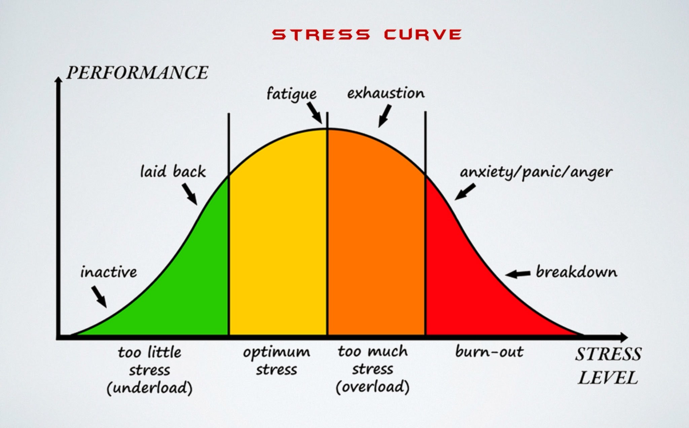
The Stress Curve
Notes:
Discuss the stress curve and how we have optimum levels of stress which increase our performance and how too little stress can cause underperformance and stagnation. Ask participants if they can think of indicators of when they are “too stressed” and “Burned out” how does this impact thinking, responses, performance and behaviour? List responses on the flip chart

Slide 11
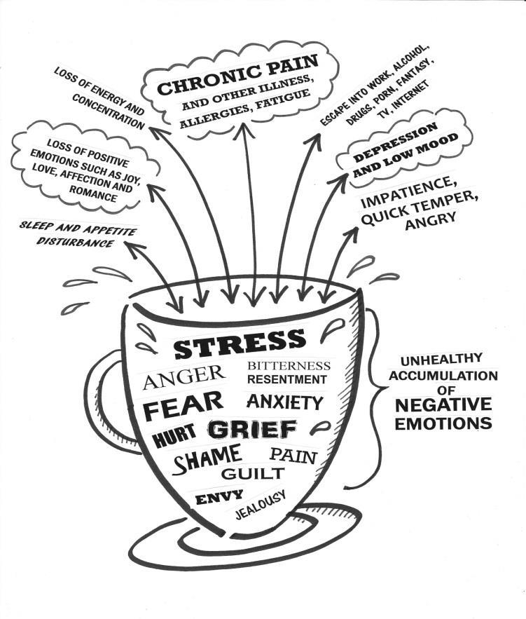
Notes:
Large group discussion – 10 minutes (read slide and allow answers)

Slide 12
Sabotage!
It‘s valuable to reflect on your SABOTEURS.
It could be your inner critic, an unsupportive colleague, your overly packed schedule, or even an unhealthy habit – what do you read, watch etc?
What are yours?

Slide 13
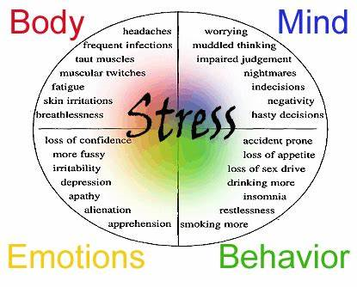
Notes:
Read slide – outline the way stress can manifest in these four areas

Slide 14

Self Care
The antidote to Stress

Slide 15
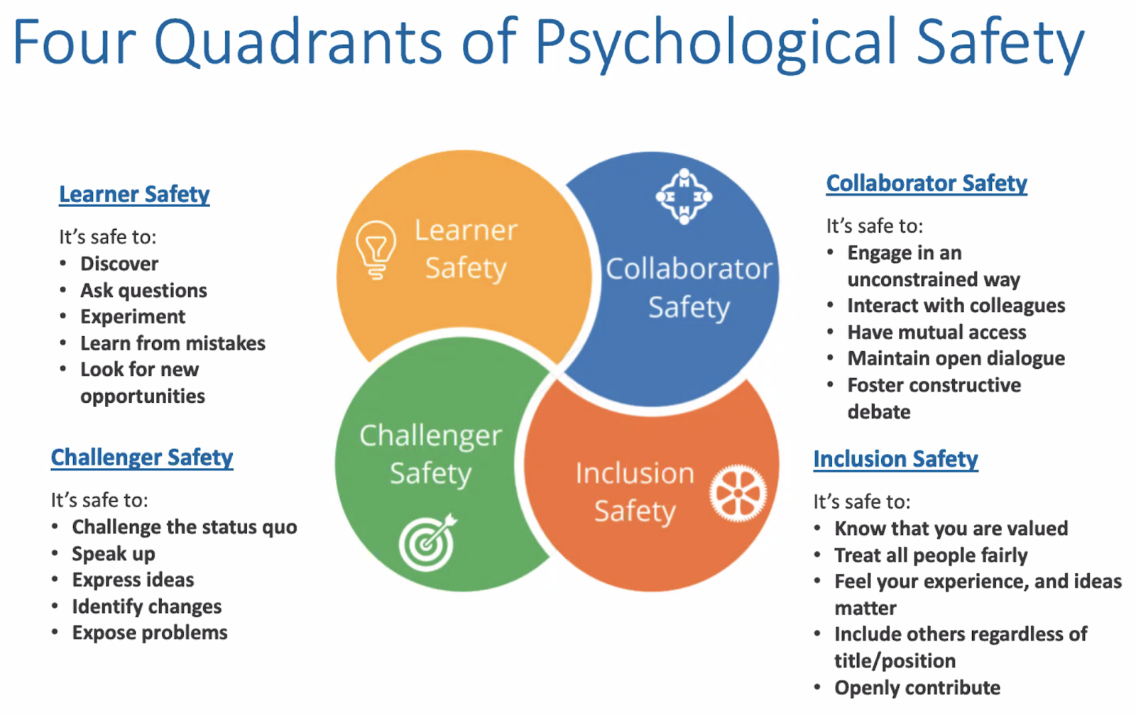

Slide 16
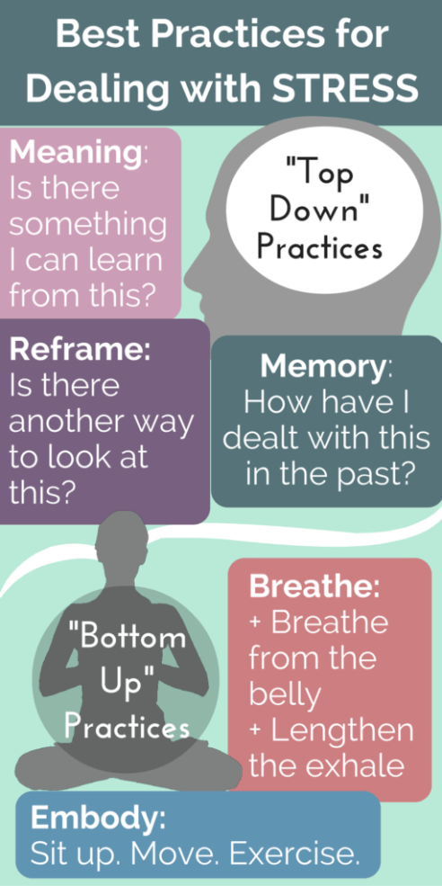
Bottom up & Top Down
Stress management techniques
Notes:
Outline different top down and bottom up exercises to support reduction of stress. Ask participants to make a note of three top down and three bottom up techniques of their own. Allow ten minutes for completion
Image from http://leftbrainbuddha.com/stress-management-top-bottom/

Slide 17

Modelling the model

Slide 18
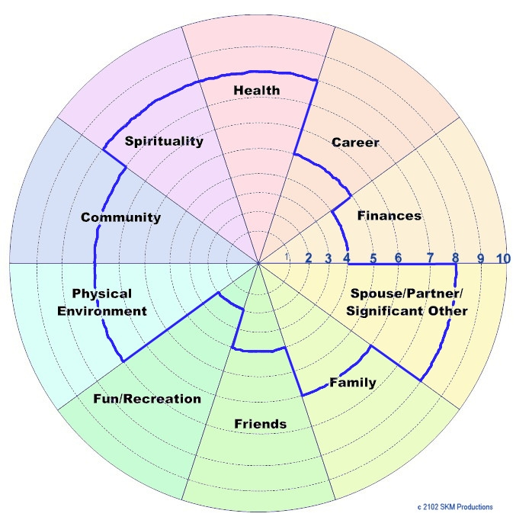
Notes:
Explain that the wheel should look roughly circular, however often is can look more like the image above.
This helps us identify areas where we can identify that in our wellbeing we are falling short – we can use the self care wheel to help us tune in to setting those goals.

Slide 19
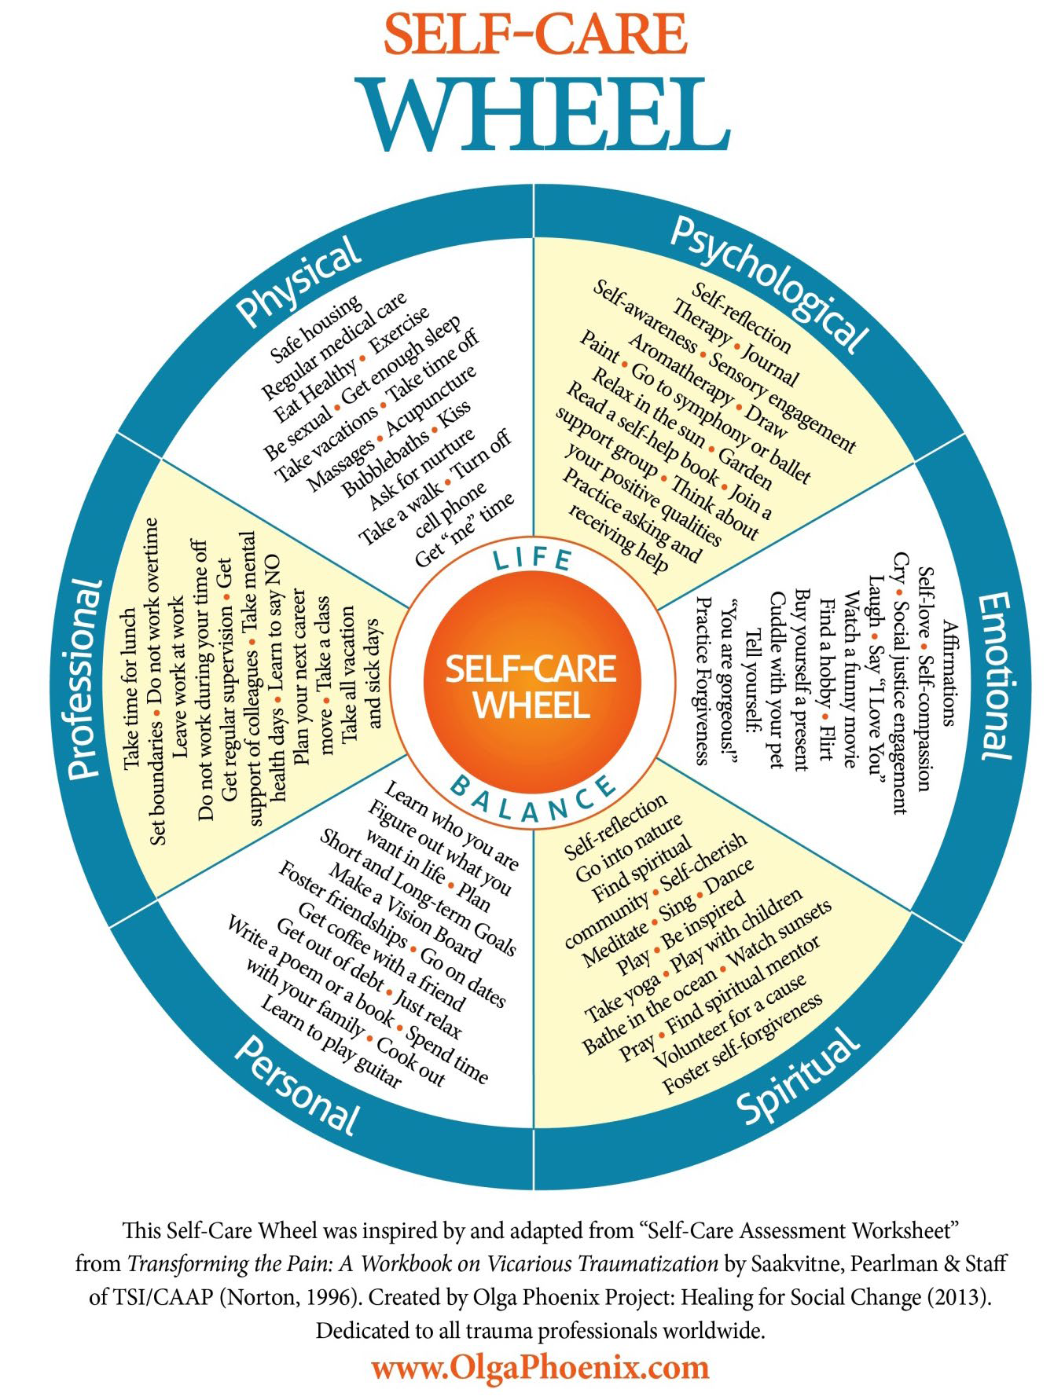
www.olgaphoenix.com
Notes:
Olga phoenix – A workbook for vicarious traumatisation – ask participants to clarify areas where they scored lower than a 5 on their wheel of life to choose two items from each of those domains that they could implement in the next couple of weeks to improve their wellbeing.

Slide 20
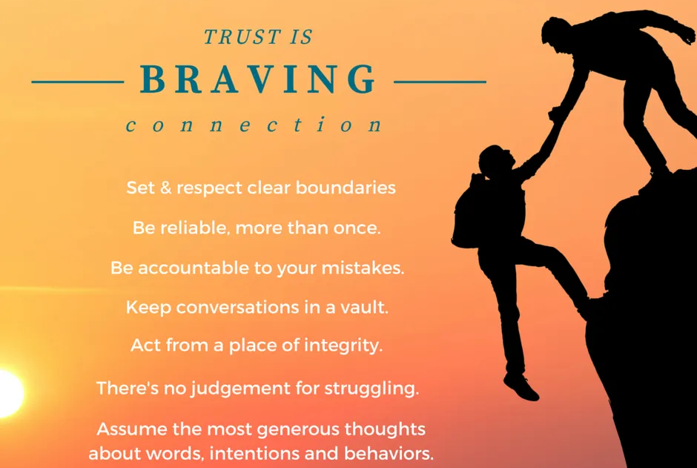
Using “Braving” to support us with connection in the workplace

Slide 21
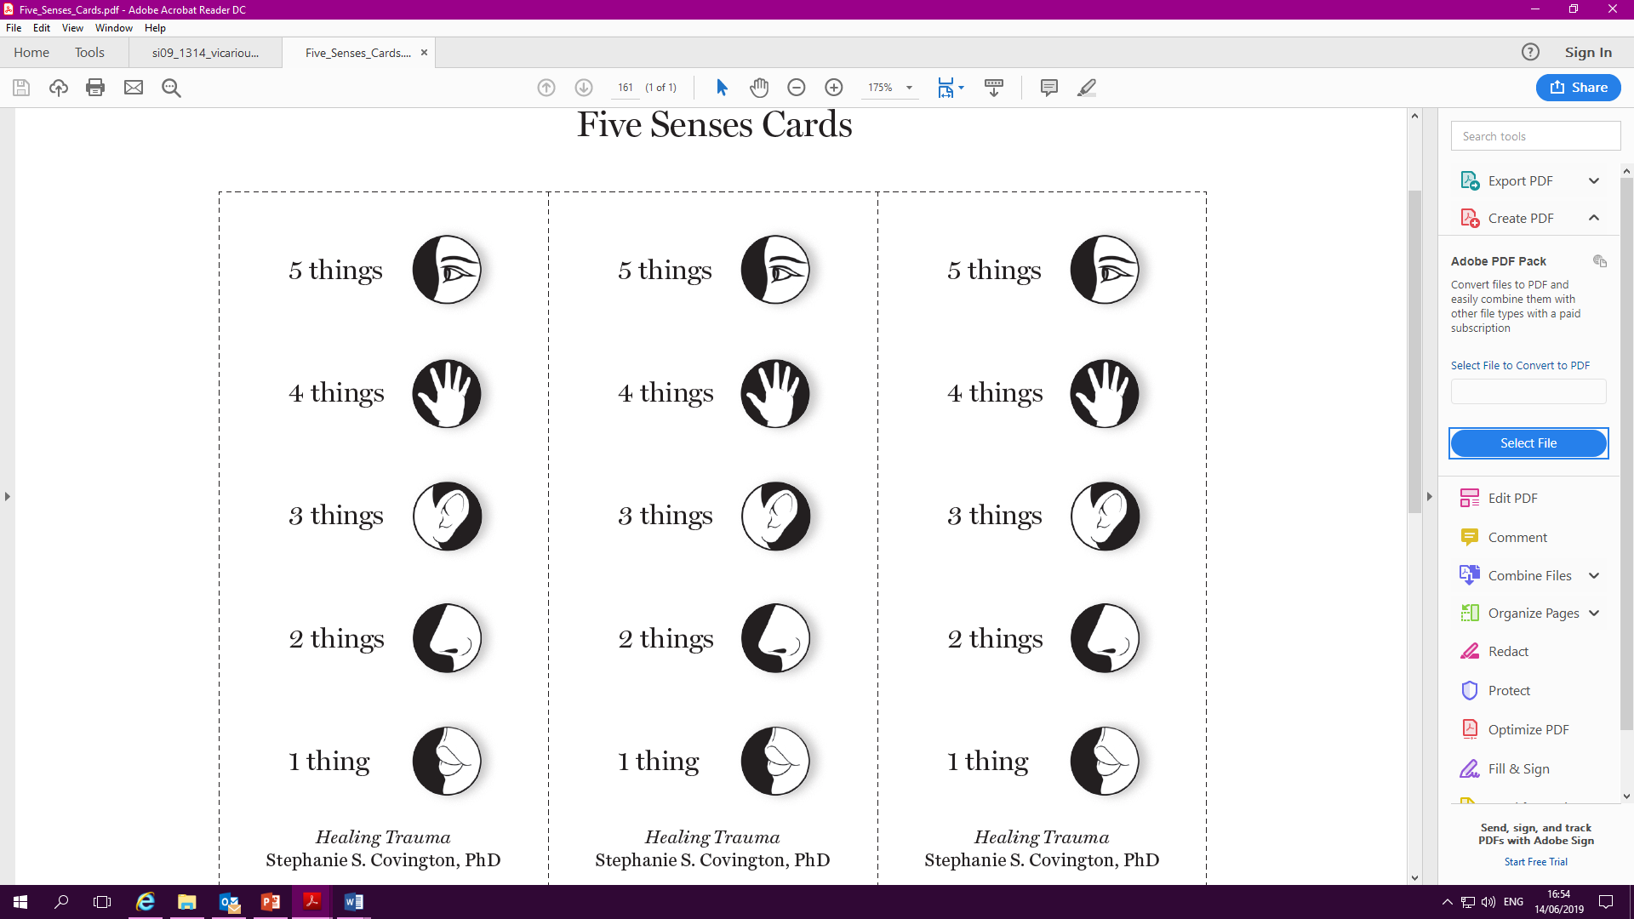
Take a moment to ground before you leave todays session
Notes:
Take participants through Healing Trauma – Five sense exercises to support them to ground before handing out evaluation forms.

Slide 22

Your relationship with yourself sets the tone for every other relationship you have.
Alice Walker
Notes:
Read slide – remind that it is our level of connection with self, and our wellbeing that directly impacts our ability to connect with others.
Hand out evaluation forms – outline that the top box on the evaluation form is left blank for participants to self define that learning outcome.

