Slide 1

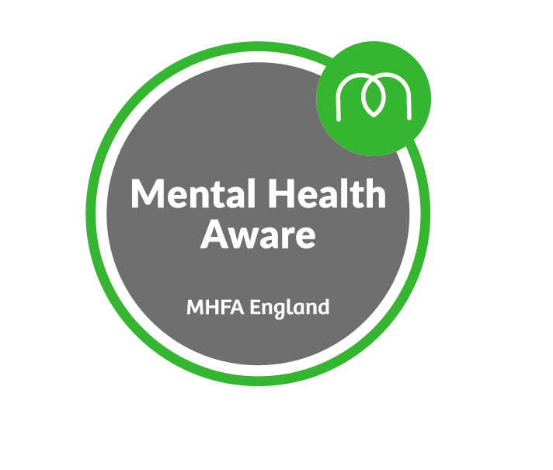
Building Good Mental Health & Resilience Within The RugbyFamily

Slide 2
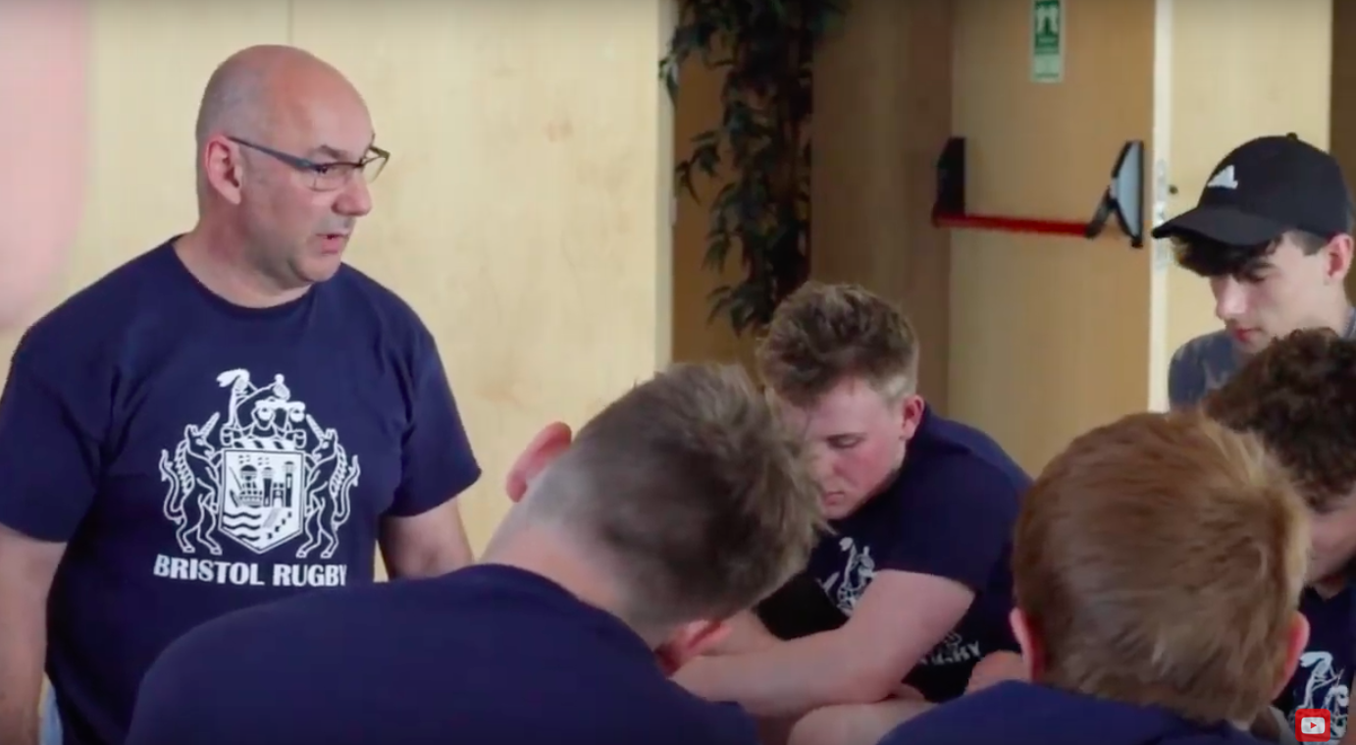
Rich Berry
Teacher
Former Headteacher
Centre Manager Bristol Bears Academy Aspire programme
Bears Academy Education/Safeguarding Lead
GRFU Mental Health & Well Being Ambassador
Trauma Informed Practitioner
RFU Safeguarding Trainer
MHFA Trainer

Slide 3

My Learning
Headteacher /Sports coach
Notes:
My journey
Bears Academy
Junior club coach academy coach

Slide 4
Relationships are key:
“Research suggests that many of the vulnerabilities men & women feel in midlife, when the risk of suicide is at its highest, are established in childhood and adolescence, and that the needs of boys and young people need attention to prevent difficulties in later years”
- Charlie Waller Trust

Slide 5
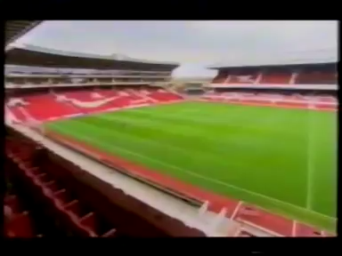
Ian Wright Footballer
Notes:
Desert Island Discs
Domestic violence
Everyday people

Slide 6
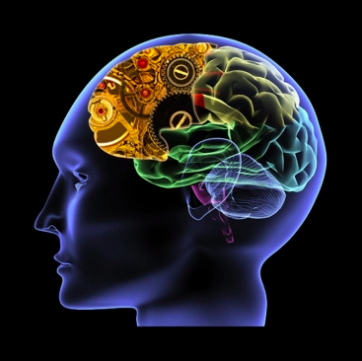
As coaches we have always focused on physical fitness but in today’s society we now need to have an understanding and sympathy for mental fitness
Notes:
Role to educate coaches within our game and beyond.
Traveled the country

Slide 7
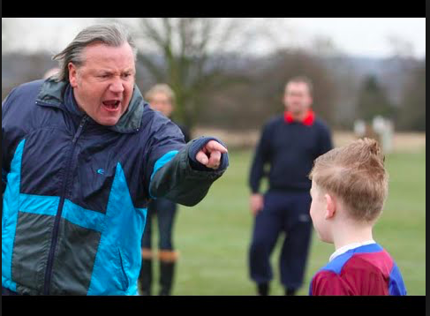
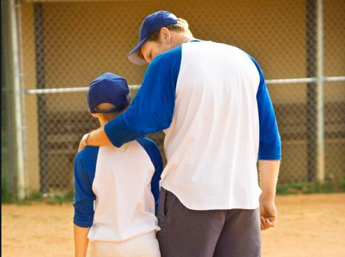
We are adult role models & how we relate to our children is crucial, we have the ability to grow them or crush them with the words we use.

Slide 8
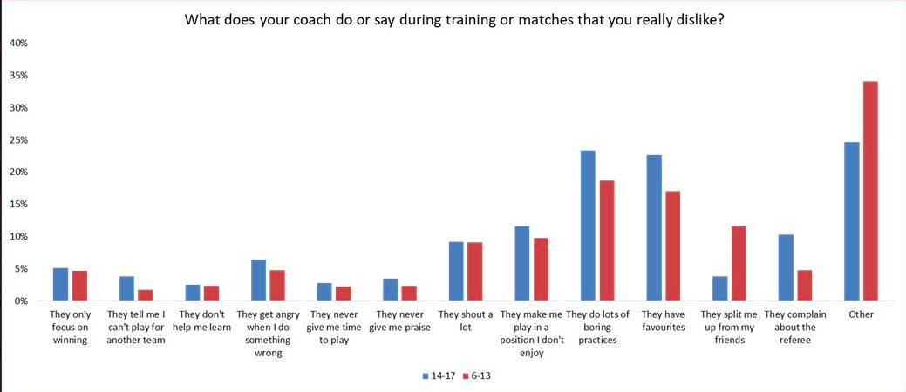
National Rugby Survey 2018

Slide 9
Take yourself back to school. Think about some adjectives that describe your best & the worst teachers.
The Best
Engaging
Charismatic
Energising
Funny
Supportive
Helpful
The Worst
Belittling
Sarcastic
Boring
Self centred
Dis-organized
Shouty

Slide 10
We can help to grow our young people to be more emotionally resilient by being emotionally intelligent adults. By showing empathy, by not shouting, by praising them and letting them play.
Notes:
Coaches feel safe with structure
We need to let young people explore to learn

Slide 11
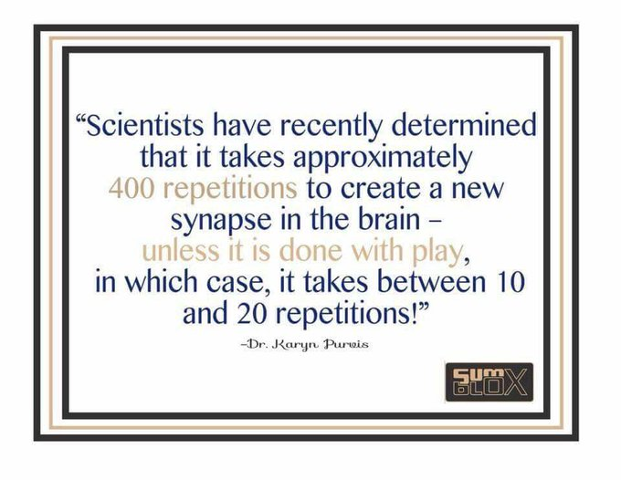

Slide 12
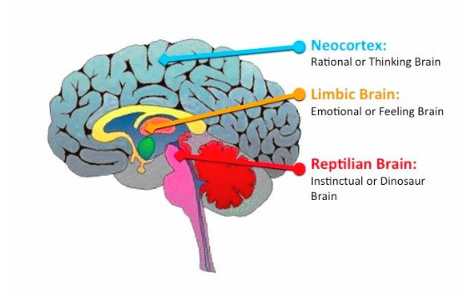
How the brain grows
Notes:
Triune brain theory - The little book of Big Stuff about the Brain - Dr Andrew Curran chief paediatric neurologist at Alder Hay

Slide 13
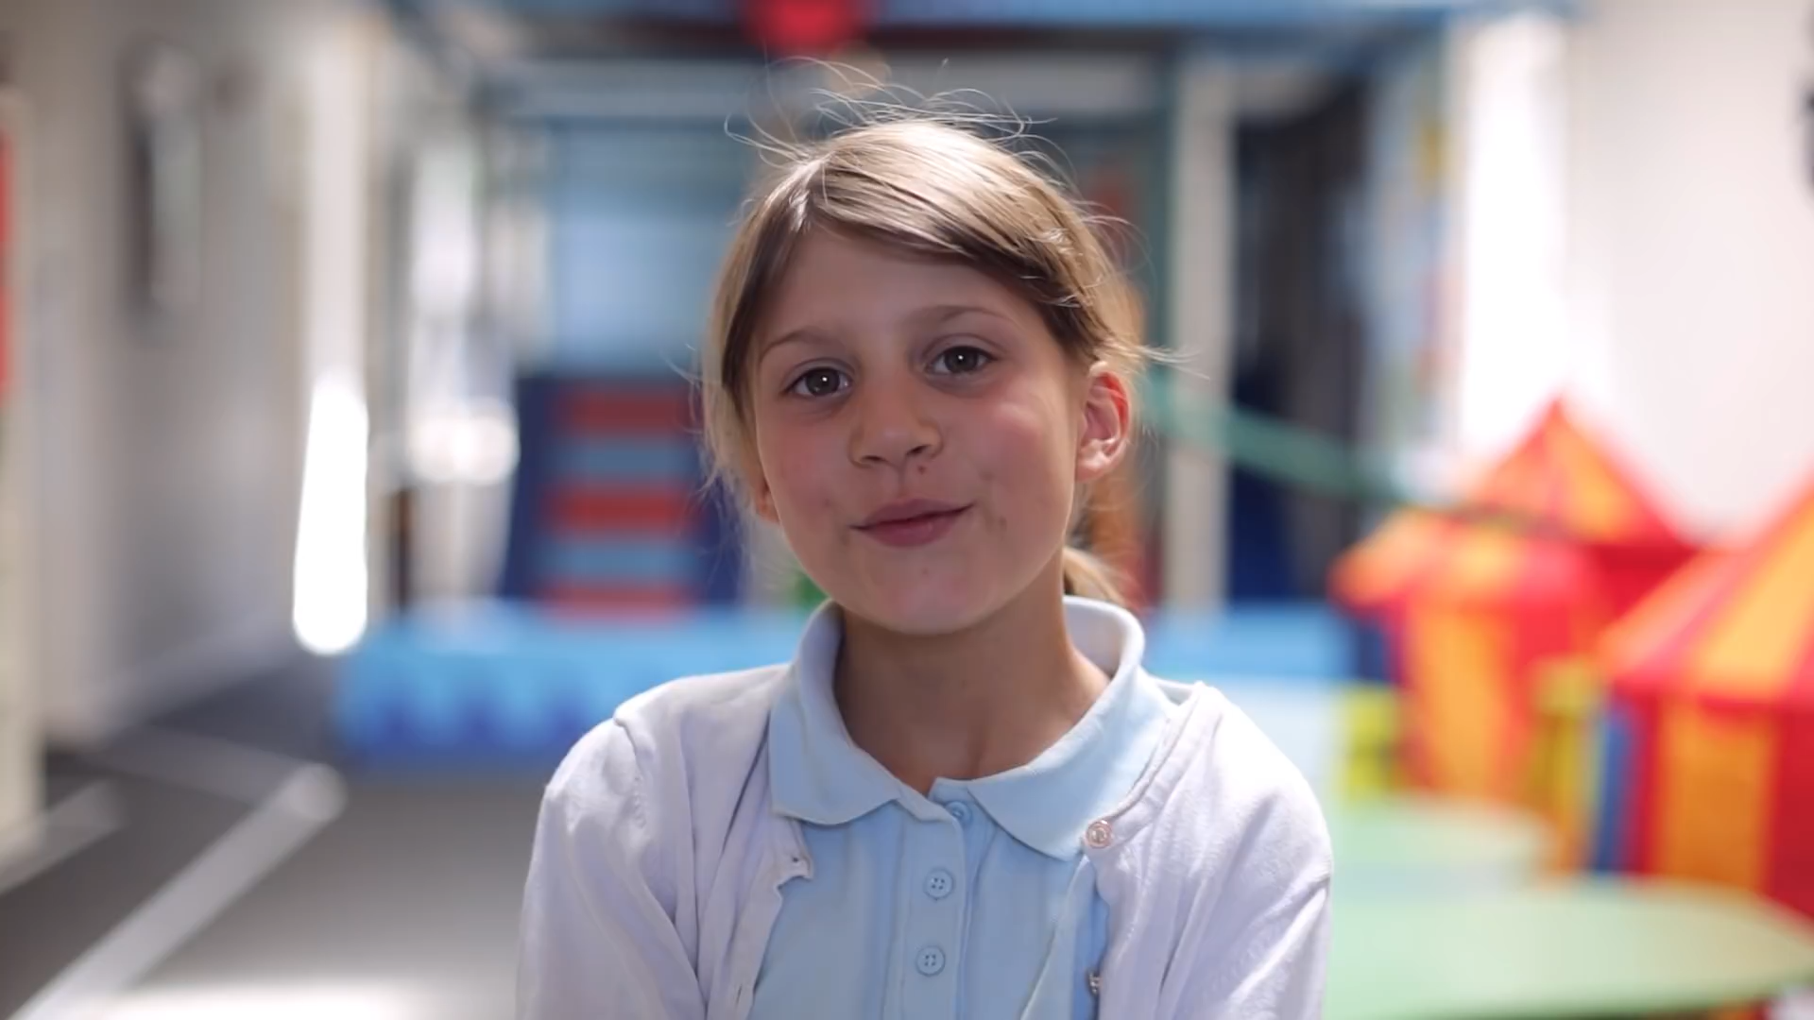
Triune Brain Theory is simplistic but helps us understand

Slide 14
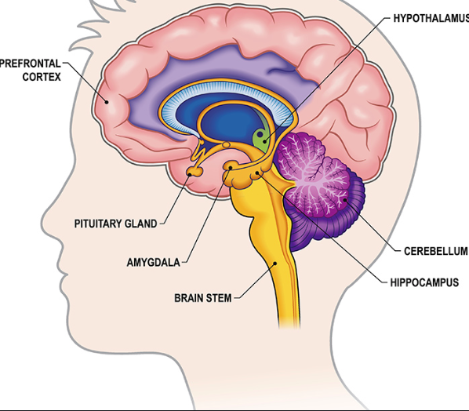
What happens when the fire alarm goes off?
Notes:
Amygdala responses everything else shuts down
Spiders!!!
What is more important rational thinking or immediate life preservation? ….........
For some of us the lack of love care and nurture in early years affects how we inter-relate and how we cope with stress and anxiety.
How we support each other, the families and young people with whom we work will dictate how they manage both now and in the future.

Slide 15
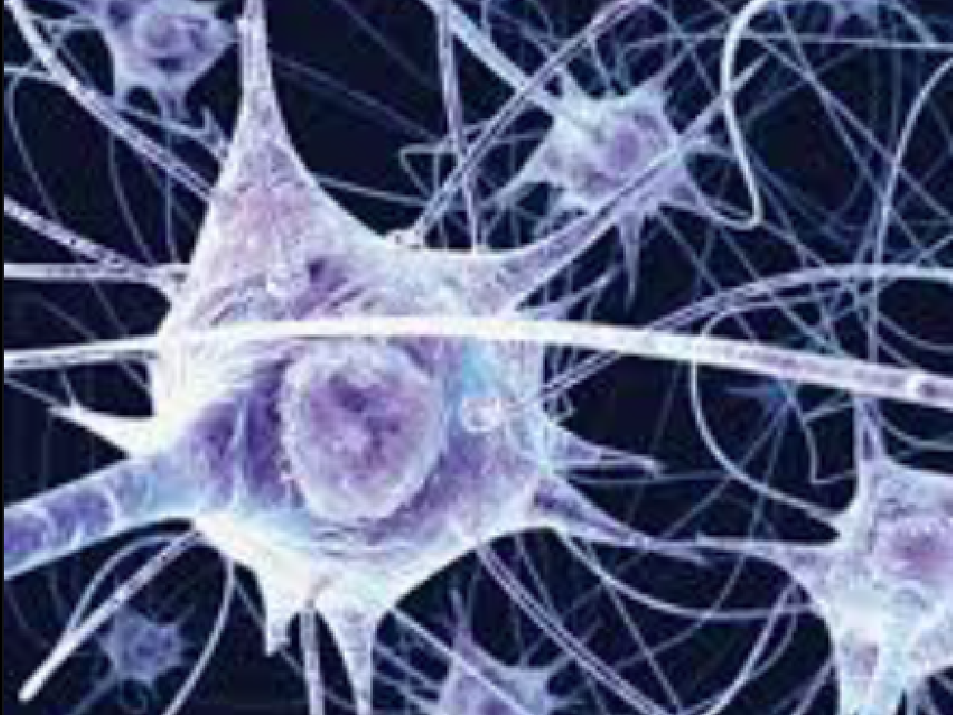
Trauma affects our Mental Health……
In order for our limbic brain to grow in a way that stops our brain stem from being dominant a child has to experience emotional connection with the adults around them. We know that the limbic brain never stops creating templates of good and bad emotional experience. However, those who experience early neglect & or trauma are more likely to experience a poor mental health episode through their life.
Notes:
In order for our limbic brain to grow in a way that stops our brain stem from being dominant a child has to experience emotional connection with the adults around them. We know that the limbic brain never stops creating templates of good and bad emotional experience. However, those who experience early neglect & or trauma are more likely to experience a poor mental health episode through their life

Slide 16
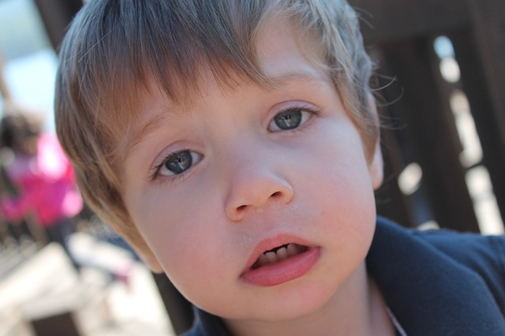
What is Trauma?
‘A psychologically distressing event that is outside the range of usual human experience, often involving a sense of fear, terror and helplessness.’
Perry (2011)
‘Trauma happens when any experience stuns us like a bolt from the blue; it overwhelms us, leaving us altered and disconnected from our bodies. Any coping mechanisms we have had are undermined, and we feel utterly helpless and hopeless. It is as if our legs are knocked out from under us.’
Levine (2006)

Slide 17
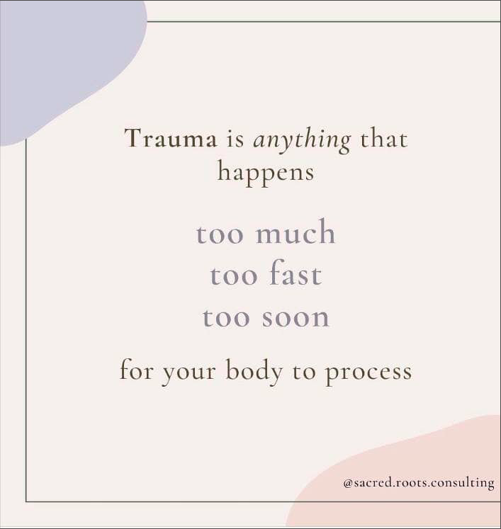
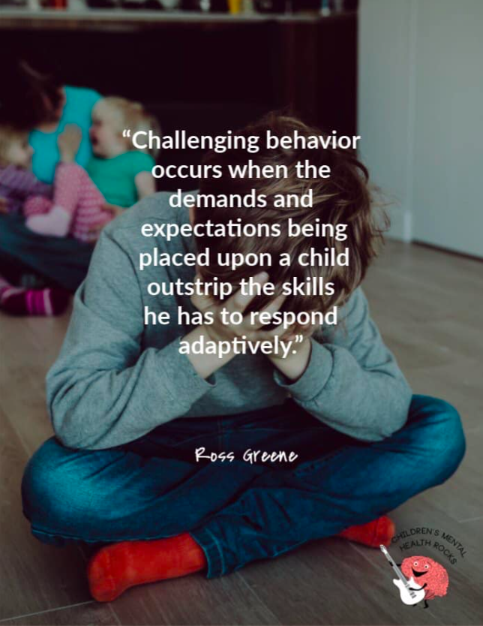

Slide 18
So! let's think about the potential impact on emotional wellbeing in light of the pandemic!
UK Stats
Pre-pandemic 50% of Mental ill Health issues were embedded by the age of 14 & 75% by the age of 18.
In a 2018 OECD survey of 15-year-olds , the UK ranked 29th for life satisfaction out of a total of 30 OECD Countries (Organisation for Economic Co-operation & Development)
In 2019 10% of Primary aged pupils suffered with low self of wellbeing.
In 2019 13% of young people aged 5 – 19 met the clinical criteria for mental health disorder.
The lived experience we have witnessed indicates the impact is huge on everyone.
NHS Digital have now said the impact could be as great as 1:4 young people being affected by Mental health issues.

Slide 19
Why does trauma lead to potential mental ill health issues
The work of Professor Aiden McCrory at the Anna Freud Institute of Child and Adolescent Mental Health explains really it really well.

Slide 20
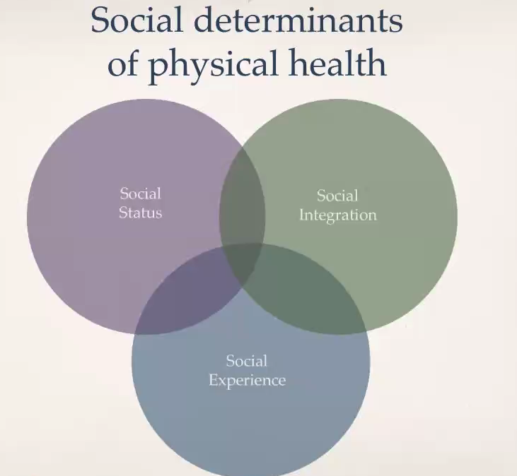

Slide 21
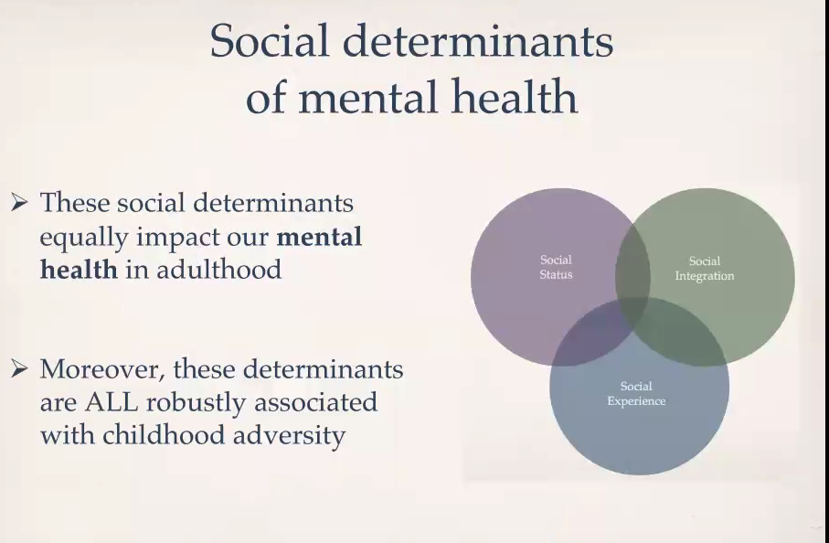

Slide 22
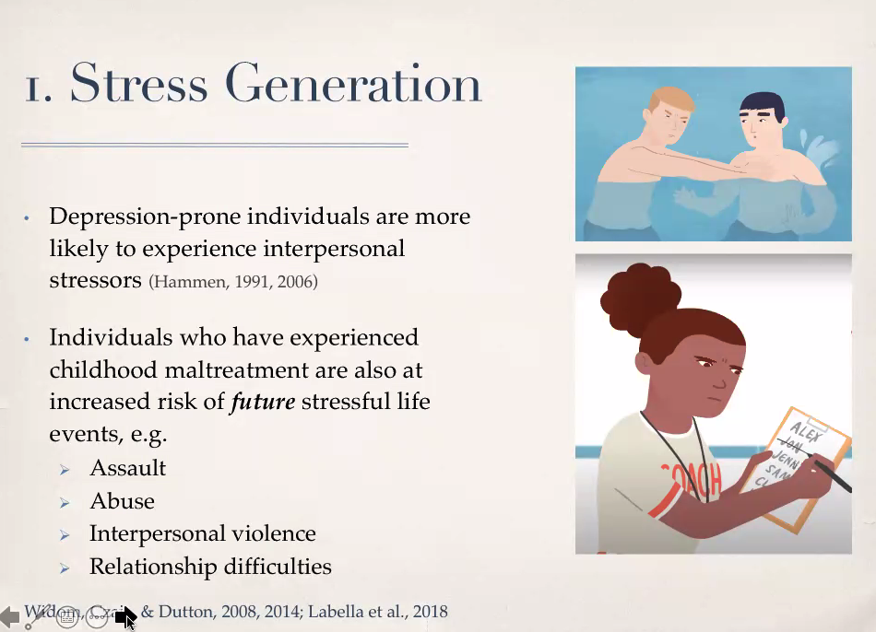

Slide 23
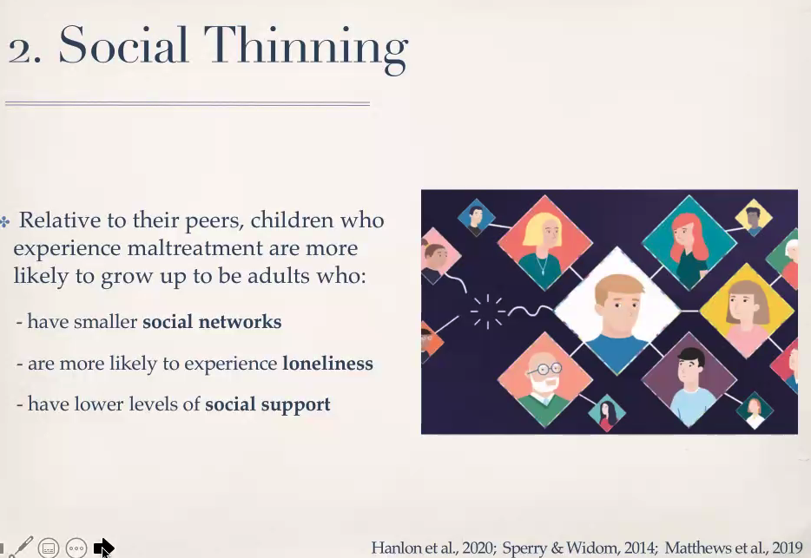

Slide 24
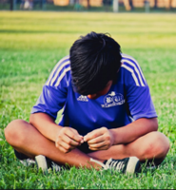
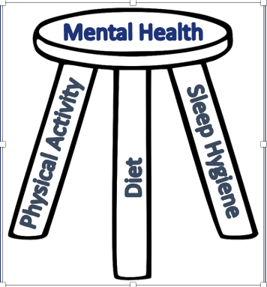
What's the impact on everyone’s mental wellbeing?

Slide 25
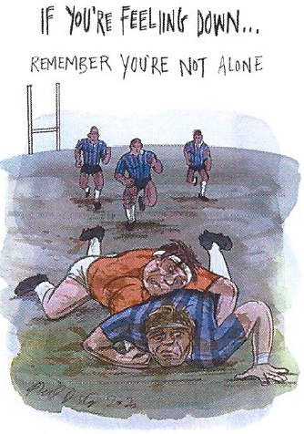
The Cauliflower Ear Project
What we are going through is unprecedented.
We wouldn’t be human if we didn’t have mood swings.
Being cooped up at home has probably lead to some interesting times and undoubted rows.
You have probably looked for connectivity with others via social media.

Slide 26
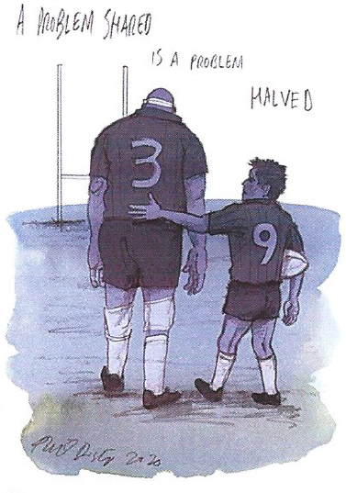
The Cauliflower Ear Project
It’s ok not to be ok!
It’s good to talk!
You see these phrases bandied about, what we know is the hardest bit is to own up to feeling low.
The macho world of rugby doesn’t help sometimes.
But things are changing so if somebody asks you how you are don’t push them away.
If you are worried about a mate ask and keep asking.

Slide 27
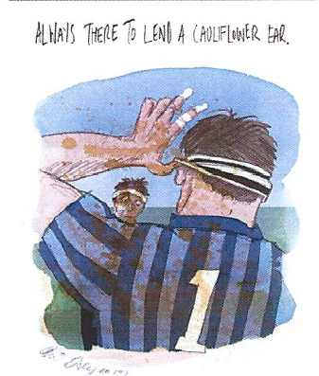
The Cauliflower Ear Project
If it is too difficult to talk to others, we are here to listen or can signpost you to someone who can help!

Slide 28
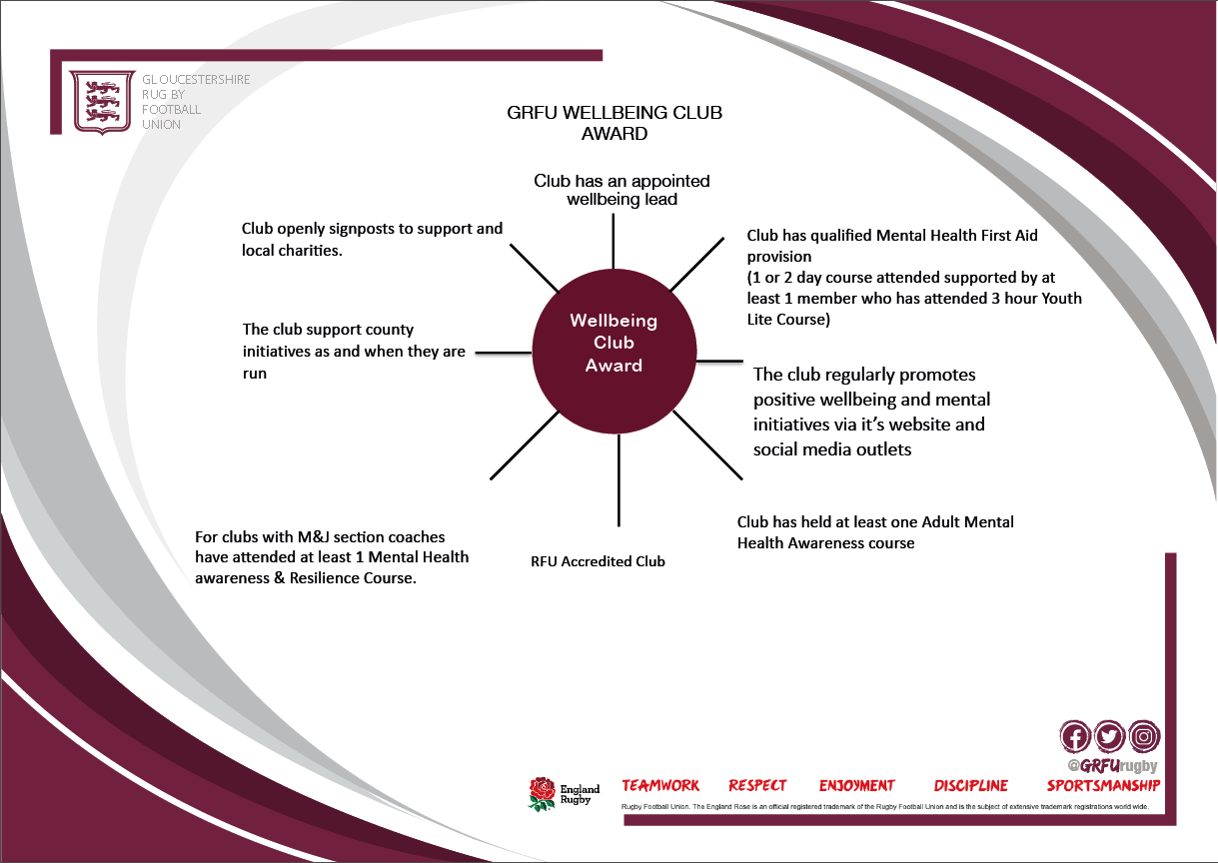

Slide 29
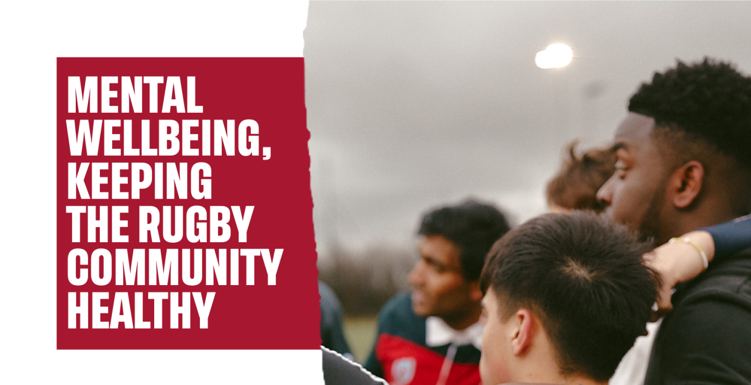
Resources
www.englandrugby.com > participation > Playing Player welfare > mental health

Slide 30
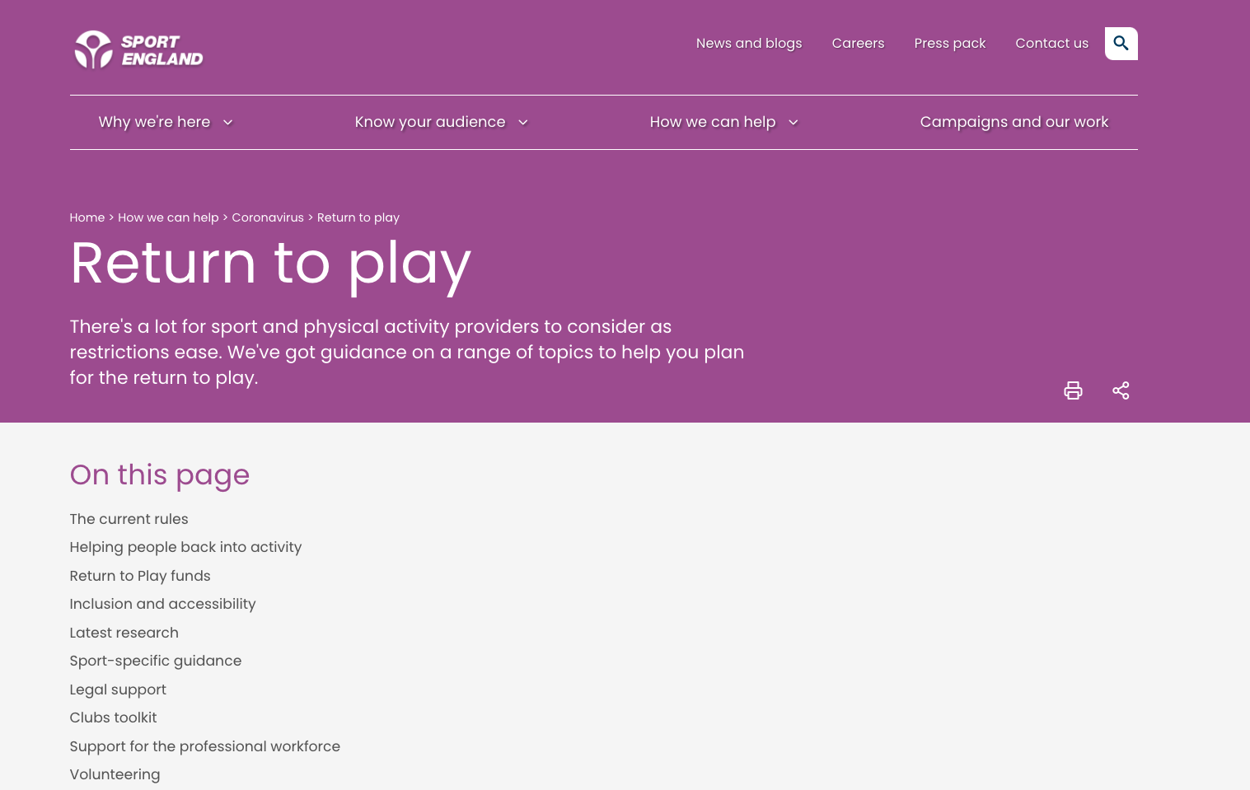

Slide 31





Signpost to services
Notes:
TIC North
OTR Bristol

Slide 32

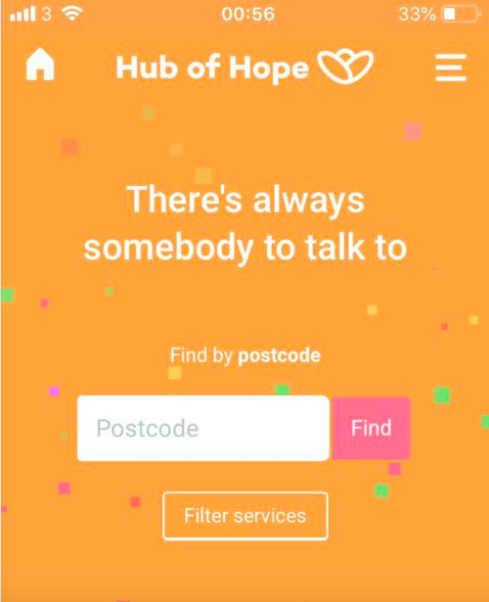





Signpost to services
Notes:
TIC North
OTR Bristol

Slide 33
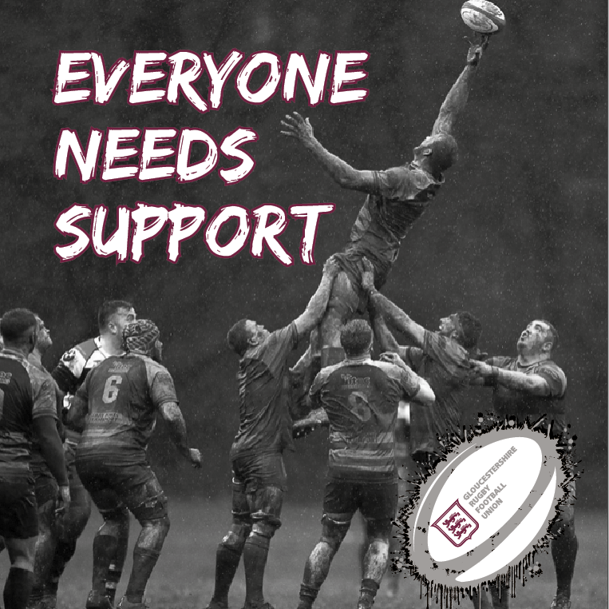
@RichBezzer
richberry@grfu.org
#Everyoneinmind
#Everyoneneedssupport

Slide 34
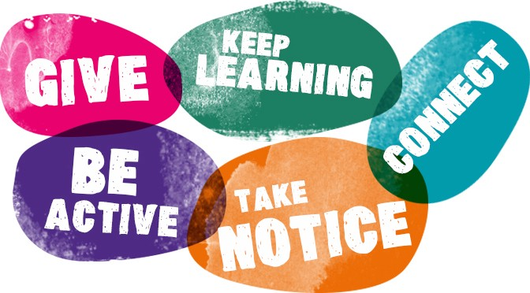
Looking After Ourselves

