Slide 1
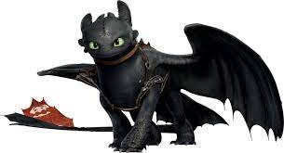
The power of leading restoratively, without the fear of the dragon
Yvette Fay & chantel yeates
Taming the Dragon

Slide 2
Iffley school:
Who am I?
Context of our school:
176 students, aged 11-18 years old.
Based in Oxford, near the city centre. Have students from across the county.
Moderate Learning and Cognition Needs, Autistic Spectrum Disorder (ASD) and Social, Emotional and Mental Health Needs (SEMH).
Cohort of learners has changed significantly over the last 5 years.
Restorative school for 15+ years.
Gained the Restorative Justice Council mark in 2018, first SEND school to achieve this.
Recently moved into a brand new building.

Slide 3
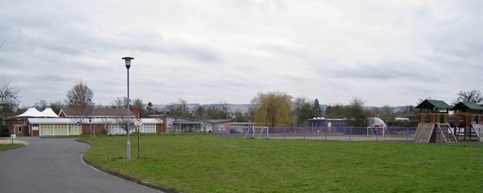
Belmont school, cheltenham
Who am I?
Context of our school :
157 pupils (Ages 6-16)
Moderate Learning and Cognition Needs, Autistic Spectrum Disorder (ASD) and Social, Emotional and Mental Health Needs (SEMH). COMPLEX NEEDS
70 staff (20 teachers; 30 LSW’s; 5 Learning mentors; 8 HLTA’s; Admin)
5 classes in primary & 11 in secondary
Class size < 12 (with 1 or 2 LSW’s)
Interventions team
RELATIONAL SCHOOL – Ace Aware; Trauma Informed & Restorative Practice

Slide 4
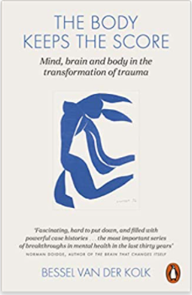
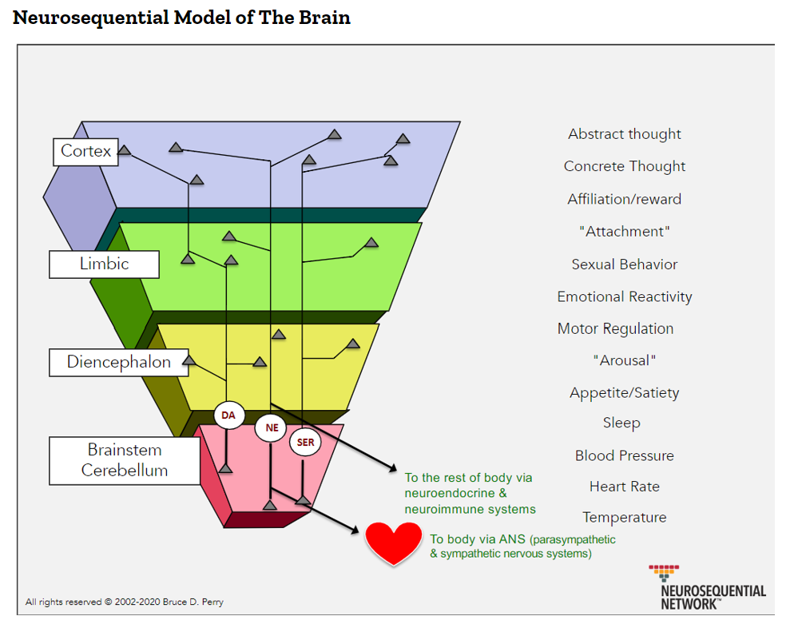
Why restorative at an ace conference?
As Bessel Van der Kolk clearly states ‘The body keeps the score’
Dr Bruce Perry -Neurosequential Model
What happened to you?
Understanding ourselves, our past, our emotions, our responses, our thoughts and our reactions especially when conflict arises.
(Recognise; Re-train & Re-progamme)

Slide 5
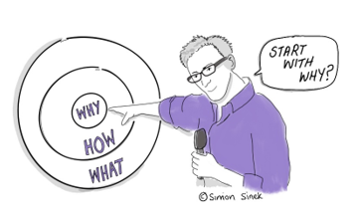
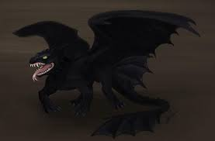
WhY, HOW & WHAT?
Restorative leadership, the focus of our presentation
Simon Sinek leadership expert-Golden Circle theory
WHY-a purpose, cause of belief
HOW-the things that make you special or set you apart
WHAT-what you do, the service you have
Theory is about leading through cooperation and trust, which clearly links to a restorative approach
Restorative leadership is more than a leadership style it is a mind-set, constantly engaging with the ‘why’ and using this leadership structure can contain your dragon and others’.

Slide 6
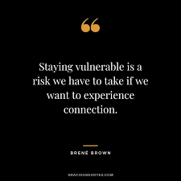
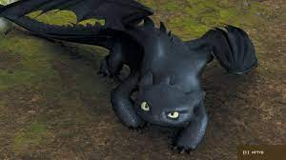
The Dragon metaphor…
Paradox
As a leader, there may be a perception or feeling that to be an excellent leader you have to be fierce, tough and breathe fire…or at least have these elements within your repertoire or armour. This thought/belief may come from external sources and pressures or may come from your own internal dialogue.
A Restorative Leadership approach supports and encourages you to face and understand your hidden dragon and in turn, work with others to understand their hidden dragons. By facing and engaging with your hidden dragon you are able to successfully lead cultural change, move a whole ethos forward, develop meaningful relationships and understanding and develop inclusive and consultative strategy…without having to breathe fire!

Slide 7
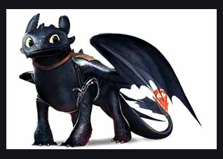
Tame the dragon…
Masks and Armour
Listening and observing
Vulnerability
Honest communication
Resilient
Fire/Breath = How?
Fire can be scary and intimidating but removing your mask, as a leader, can also feel like this. As a restorative leader you are thinking about the needs of each person, working with others and forming a cohesive pathway forwards.
Longevity
Spikes = What?
Its not always easy, spikes can be difficult and spikey and unexpected!
As a restorative leader you are having a restorative mindset to develop whole school culture.
Belly = Why?
You often feel your purpose or belief in your belly. You know it’s there but do you communicate that clearly? As a restorative leader you need to look inwards and face your ‘why ’before facing outwards. You then need to engage with others and understand their why.
Courage
Emotions
Pressure

Slide 8
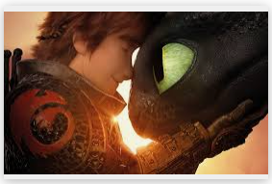
Understanding the ‘belly’ of the dragon (Why?)
Belly = gut feel; instincts; emotions; trauma; feelings; understanding of ACE’s and the impact.
Leadership (Why) Know your staff. Again…What happened to you? Provide the knowledge and understanding for themselves and to support pupils. Model the behaviour you wish to see. Have courage & vulnerability (Brave & Afraid).
Students (Why) The behaviour we see shows an unmet need. A form of communication. What happened to you? Be curious, take time to listen, observe and think about the pupils in your care. Help them understand themselves, their brains, their behaviour.
Co-regulation leads to
self-regulation.

Slide 9
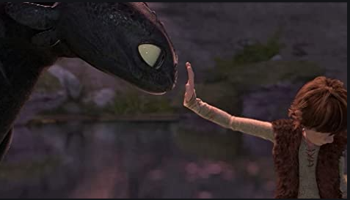
Understanding the ‘breath’ of the dragon. (How?)
Breath = Communication; Restorative language; Ethos; Vibe & way of being
Students (How)- Embedding systems to build and understand emotions, problem solving and encouraging positive communication without blame through Mend-it meetings, using positive language, developing a ‘with’ approach through students developing their own classroom expectations, family service lunches, Circle times, regular ‘check ins & check outs’
Leadership (How)-Office structures, policies exuding and embedding a restorative approach for example having a non exclusion policy, meetings, CPD/observations which are enquiry and questions based-identifying next steps together. Circle times, regular ‘check ins’ & ‘check outs’
Relational Environment essential for ALL

Slide 10
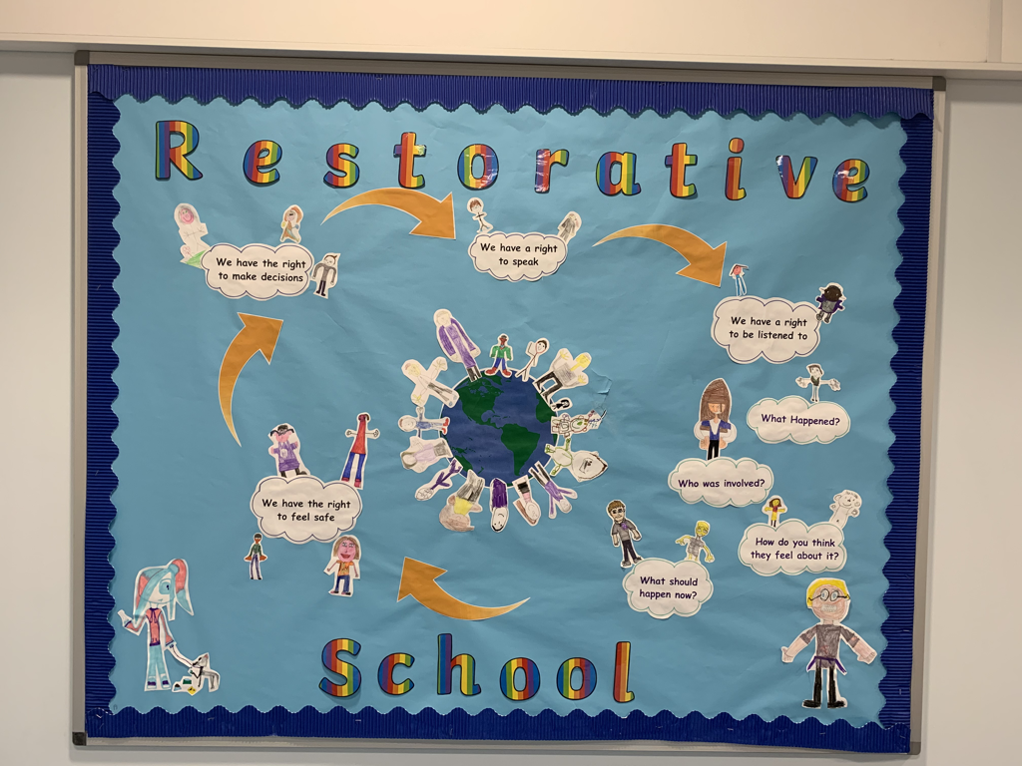
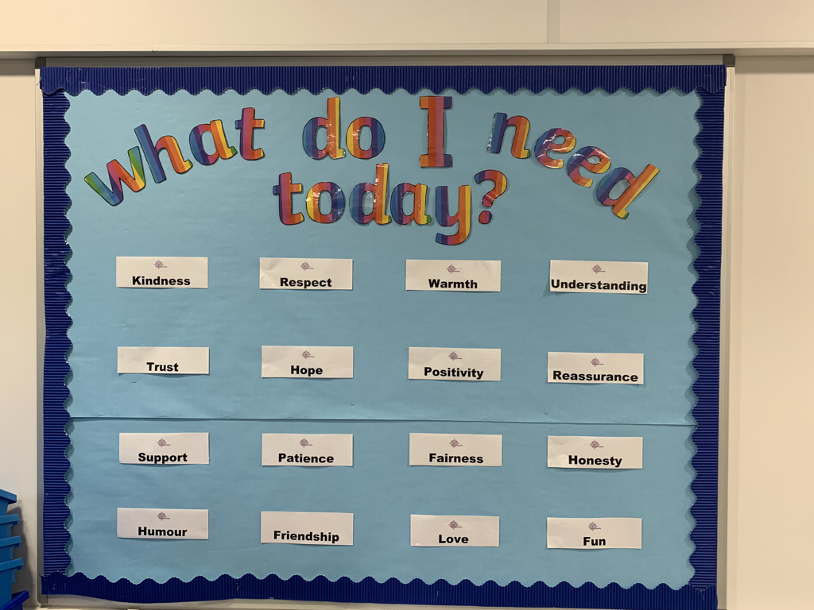
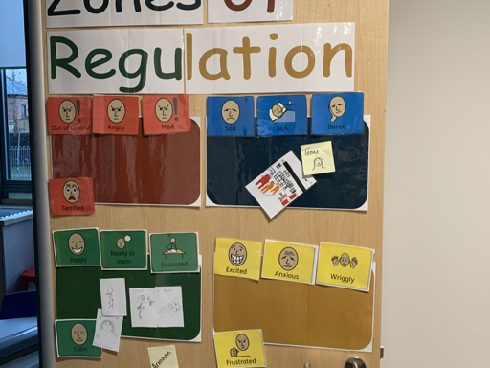

Slide 11
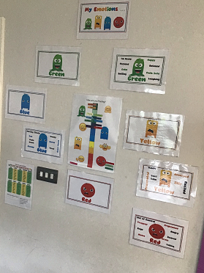
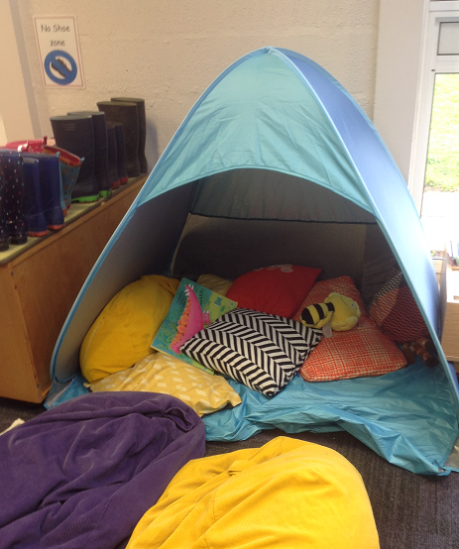
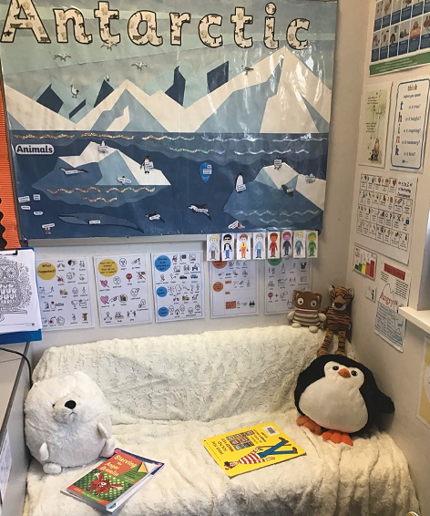
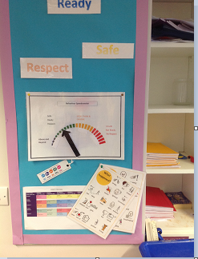
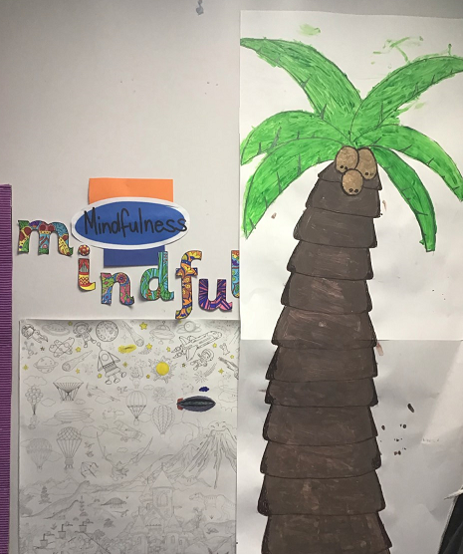
Regulate
Soothe
Staff wellbeing
& Circles
Calm

Slide 12
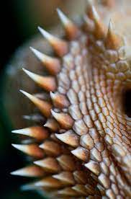
Understanding the spikes of the dragon (What?)
Spikes- Challenges: peaks & troughs, sometimes sharp, all slightly different. Students (What)-Support, teach, coach and champion students to be emotionally resilient, to recognise their own needs, to be able to problem solve and build meaningful relationships. (Reduce impact of Aces, teach skills to cope with impact of Aces.)
Leadership (What)-Consistently embody, review and evaluate a restorative mindset to support student development and build a cohesive, reflective and emotionally resilient staff.
Circles for ALL

Slide 13

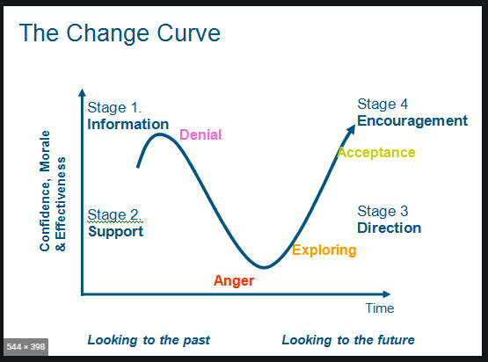
Leadership challenges
Personal challenges – your own ace’s, barriers, resistance from staff & parents
Managing change and culture – slow and make sure your staff are onboard.
Buy in & consistency & relapse & retrain & new staff

Slide 14
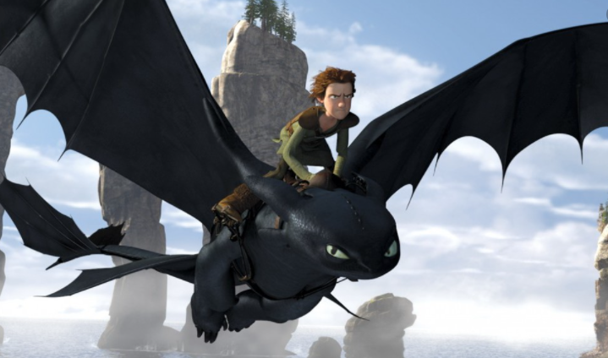
Where to next……
Contact details:
Yvette Fay – y.fay@iffleyacademy.co.uk
(01865) 747606
Chantel Yeates – cyeates@Belmont.sandmat.uk
(01242) 216180

Slide 15
Further reading & ideas
https://www.ted.com/talks/simon_sinek_how_great_leaders_inspire_action/up-next?language=en (TED talk about Golden Circle)
Radical Help: How we can remake relationships between us and revolutionise the welfare state by Hilary Cottam
10 Mindframes for visible learning but John Hattie and Klaus Zierer
The body keeps the score – Bessel Van der Kolk
What happened to you – Oprah Winfrey and Dr Bruce Perry
The boy who was raised as a dog – Dr Bruce Perry
Know me to teach me – Louise Michelle Bomber
Dare to Lead – Brene Brown

